Slide 1
Introduction
CS 46101 Section 600
CS 56101 Section 002
Dr. Angela Guercio
Spring 2010

Slide 2
The sorting problem
Input: A sequence of n numbers 〈a₁, a₂, …, a_{n}〉.
Output: A permutation (reordering) 〈a’₁, a’₂, …, a’_{n}〉 of the input sequence such that a’₁≤ a’₂≤ …≤ a’_{n}.
The sequences are typically stored in arrays.
We also refer to the numbers as keys. Along with each key may be additional information, known as satellite data.

Slide 3
The sorting problem
We will see several ways to solve the sorting problem. Each way will be expressed as an algorithm:
a well-defined computational procedure that takes some value, or set of values, as input and produces some value, or set of values, as output.

Slide 4
Expressing algorithms
We express algorithms in whatever way is the clearest and most concise.
English is sometimes the best way.
When issues of control need to be made perfectly clear, we often use pseudocode.
Pseudocode is similar to C, C++, Pascal, and Java.
Pseudocode is designed for expressing algorithms to humans. Software engineering issues of data abstraction, modularity, and error handling are often ignored.
We sometimes embed English statements into pseudocode ➔unlike for “real” programming languages, we cannot create a compiler that translates pseudocode to machine code.

Slide 5
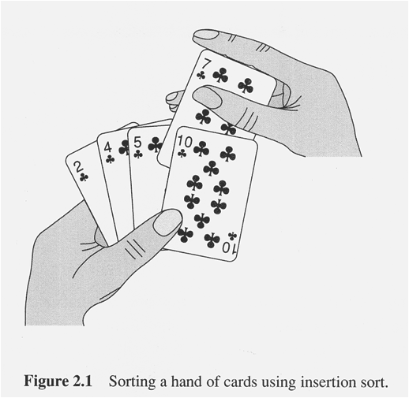
Insertion sort

Slide 6
Next Time
Insertion Sort
The algorithm
Analysis of the algorithm
The best, the worst and the average case
Reading
Until page 30 of your book

