Slide 1
Introduction
CS 46101 Section 600
CS 56101 Section 002
Dr. Angela Guercio
Spring 2010

Slide 2
The sorting problem
Input: A sequence of n numbers 〈a₁, a₂, …, a_{n}〉.
Output: A permutation (reordering) 〈a’₁, a’₂, …, a’_{n}〉 of the input sequence such that a’₁≤ a’₂≤ …≤ a’_{n}.
The sequences are typically stored in arrays.
We also refer to the numbers as keys. Along with each key may be additional information, known as satellite data.

Slide 3
The sorting problem
We will see several ways to solve the sorting problem. Each way will be expressed as an algorithm:
a well-defined computational procedure that takes some value, or set of values, as input and produces some value, or set of values, as output.

Slide 4
Expressing algorithms
We express algorithms in whatever way is the clearest and most concise.
English is sometimes the best way.
When issues of control need to be made perfectly clear, we often use pseudocode.
Pseudocode is similar to C, C++, Pascal, and Java.
Pseudocode is designed for expressing algorithms to humans. Software engineering issues of data abstraction, modularity, and error handling are often ignored.
We sometimes embed English statements into pseudocode ➔unlike for “real” programming languages, we cannot create a compiler that translates pseudocode to machine code.

Slide 5
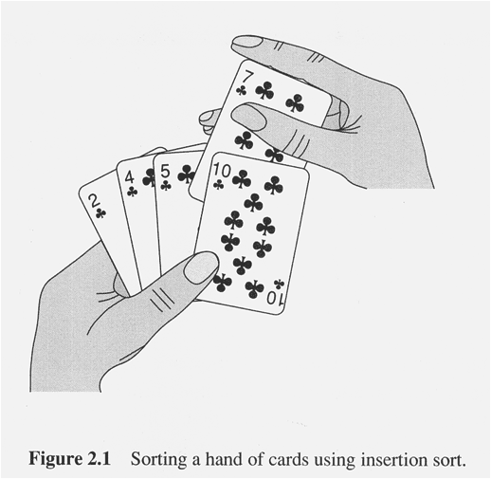
Insertion sort

Slide 6
Insertion sort
A good algorithm for sorting a small number of elements.
It works the way you might sort a hand of playing cards:
Start with an empty left hand and the cards face down on the table.
Then remove one card at a time from the table, and insert it into the correct position in the left hand.
To find the correct position for a card, compare it with each of the cards already in the hand, from right to left.
At all times, the cards held in the left hand are sorted, and these cards were originally the top cards of the pile on the table.

Slide 7
Pseudocode
We use a procedure INSERTION-SORT.
Takes as parameters an array A[1 .. n] and the length n of the array.
As in Pascal, we use “..” to denote a range within an array
The array A is sorted in place: the numbers are rearranged within the array, with at most a constant number outside the array at any time

Slide 8
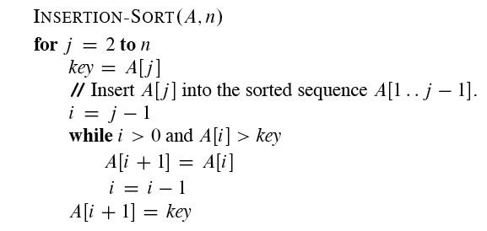
Pseudocode

Slide 9
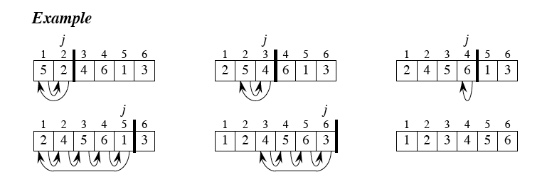
Insertion Sort

Slide 10
Correctness
We often use a loop invariant to help us understand why an algorithm gives the correct answer
Here’s the loop invariant for INSERTION-SORT
Loop invariant: At the start of each iteration of the “outer” for loop—the loop indexed by j—the subarray A[1 .. j -1] consists of the elements originally in A[1 .. j – 1] but in sorted order.

Slide 11
Loop invariants
We must show three things
Initialization: It is true prior to the first iteration of the loop.
Maintenance: If it is true before an iteration of the loop, it remains true before the next iteration.
Termination: When the loop terminates, the invariant—usually along with the reason that the loop terminated—gives us a useful property that helps show that the algorithm is correct.

Slide 12
Loop invariants
Using loop invariants is like mathematical induction:
To prove that a property holds, you prove a base case and an inductive step.
Showing that the invariant holds before the first iteration is like the base case.
Showing that the invariant holds from iteration to iteration is like the inductive step.
The termination part differs from the usual use of mathematical induction, in which the inductive step is used infinitely. We stop the “induction” when the loop terminates.
We can show the three parts in any order

Slide 13
Loop invariants
Initialization: Just before the first iteration, j = 2. The subarray A[1 .. j – 1] is the single element A[1], which is the element originally in A[1], and it is trivially sorted.
Maintenance: To be precise, we would need to state and prove a loop invariant for the “inner” while loop. Rather than getting bogged down in another loop invariant, we instead note that the body of the inner while loop works by moving A[j – 1], A[j – 2], A[j – 3], and so on, by one position to the right until the proper position for key (which has the value that started out in A[j]) is found. At that point, the value of key is placed into this position.
Termination: The outer for loop ends when j > n, which occurs when j = n+1. Therefore, j = 1 - n. Plugging n in for j - 1 in the loop invariant, the subarray A[1 .. n] consists of the elements originally in A[1 .. n] but in sorted order. In other words, the entire array is sorted.

Slide 14
Pseudocode conventions
Indentation indicates block structure. Saves space and writing time.
Looping constructs are like in C, C++, Pascal, and Java. We assume that the loop variable in a for loop is still defined when the loop exits (unlike in Pascal).
// indicates that the remainder of the line is a comment.
Variables are local, unless otherwise specified.

Slide 15
Pseudocode conventions
We often use objects, which have attributes. For an attribute attr of object x, we write x:attr.
Objects are treated as references, like in Java. If x and y denote objects, then the assignment y = x makes x and y reference the same object.
Parameters are passed by value, as in Java and C.

Slide 16
Pseudocode conventions
The boolean operators “and” and “or” are short-circuiting: if after evaluating the left-hand operand, we know the result of the expression, then we don’t evaluate the right-hand operand.

Slide 17
Analyzing algorithms
In order to predict resource requirements, we need a computational model.
Random-access machine (RAM) model
Instructions are executed one after another. No concurrent operations.
Each instruction takes a constant amount of time.
The RAM model uses integer and floating-point types.
There is a limit on the word size. Integers require c lg n bits for an input size n

Slide 18
How do we analyze an algorithm’s running time?
The time taken by an algorithm depends on the input.
Sorting 1000 numbers takes longer than sorting 3 numbers.
A given sorting algorithm may even take differing amounts of time on two inputs of the same size.
For example, we’ll see that insertion sort takes less time to sort n elements when they are already sorted than when they are in reverse sorted order.

Slide 19
Input size
Depends on the problem being studied.
Usually, the number of items in the input. Like the size n of the array being sorted.
But could be something else. If multiplying two integers, could be the total number of bits in the two integers.
Could be described by more than one number. For example, graph algorithm running times are usually expressed in terms of the number of vertices and the number of edges in the input graph.

Slide 20
Running time
On a particular input, it is the number of primitive operations (steps) executed.
Want to define steps to be machine-independent.
Figure that each line of pseudocode requires a constant amount of time.
One line may take a different amount of time than another, but each execution of line i takes the same amount of time c_{i} .
This is assuming that the line consists only of primitive operations.
If the line is a subroutine call, then the actual call takes constant time, but the execution of the subroutine being called might not.
! If the line specifies operations other than primitive ones, then it might take more than constant time. Example: “sort the points by x-coordinate.”

Slide 21
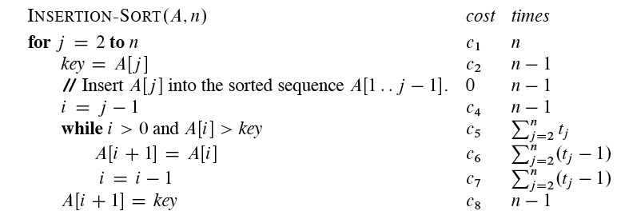
Analysis of insertion sort

Slide 22
Analysis of insertion sort
Assume that the ith line takes time c_{i}, which is a constant. (Since the third line is a comment, it takes no time.)
For j = 2, 3, …, n, let t_{j} be the number of times that the while loop test is executed for that value of j .
Note that when a for or while loop exits in the usual way—due to the test in the loop header—the test is executed one time more than the loop body.

Slide 23
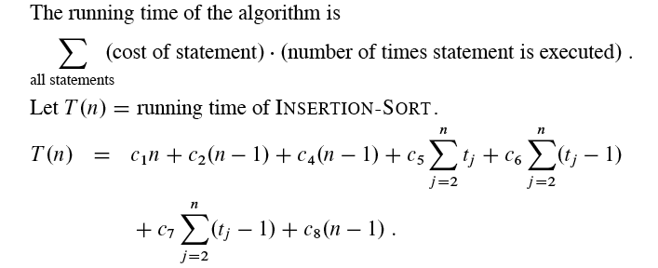
Analysis of insertion sort

Slide 24
Analysis of insertion sort
The running time depends on the values of t_{j}. These vary according to the input.
Best case
The array is already sorted.
Always find that A[i] ≤ key upon the first time the while loop test is run (when i = j -1).
All t_{j} are 1.
Running time is

Slide 25
Analysis of insertion sort
Running time is
Can express T(n) as an+b for constants a and b (that depend on the statement costs ci _{i})⇒T(n) is a linear function of n.

Slide 26
Analysis of insertion sort
Worst case
The array is in reverse sorted order.
Always find that A[i] > key in while loop test.
! Have to compare key with all elements to the left of the jth position) ⇒ compare with j - 1 elements
Since the while loop exits because i reaches 0, there’s one additional test after the j – 1 tests t_{j} = j

Slide 27
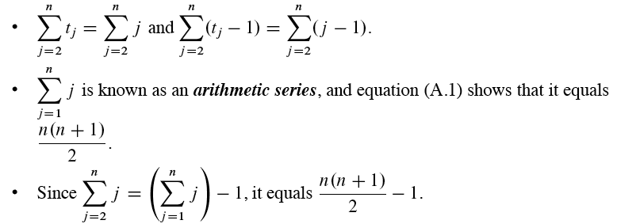
Analysis of insertion sort

Slide 28
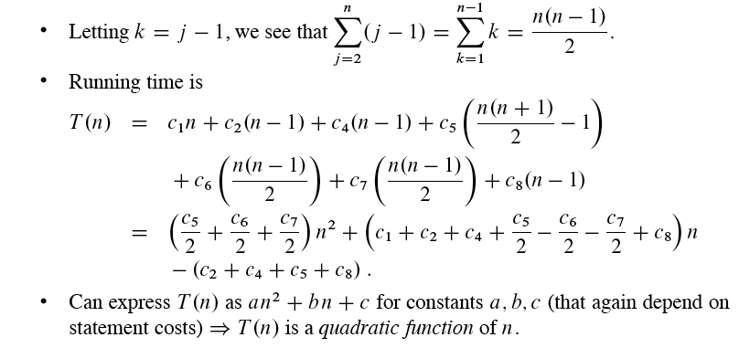
Analysis of insertion sort

Slide 29
Worst-case and average-case analysis
We usually concentrate on finding the worst-case running time: the longest running time for any input of size n.
Reasons
The worst-case running time gives a guaranteed upper bound on the running time for any input.
For some algorithms, the worst case occurs often. For example, when searching, the worst case often occurs when the item being searched for is not present, and searches for absent items may be frequent.
! Why not analyze the average case? Because it’s often about as bad as the worst case.

Slide 30
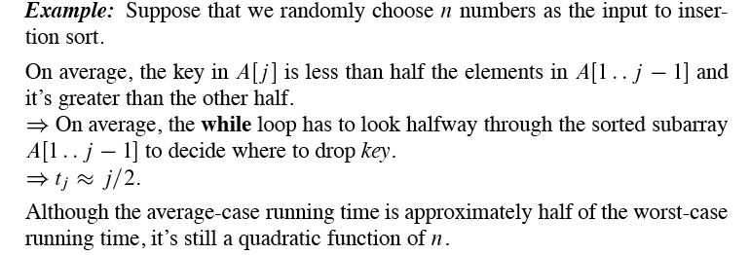
Worst-case and average-case analysis

Slide 31
Order of growth
Drop lower-order terms.
Ignore the constant coefficient in the leading term.
Example: For insertion sort, we already abstracted away the actual statement costs to conclude that the worst-case running time is an² + bn + c.
Drop lower-order terms ⇒an².
Ignore constant coefficient⇒n².
But we cannot say that the worst-case running time T(n) equals n²
It grows like n². But it doesn’t equal n².
We usually consider one algorithm to be more efficient than another if its worst-case running time has a smaller order of growth.

Slide 32
Designing algorithms
There are many ways to design algorithms.
For example, insertion sort is incremental: having sorted A[1 ..j – 1], place A[j] correctly, so that A[1 .. j] is sorted.
Divide and conquer
Another common approach
Divide the problem into a number of subproblems that are smaller instances of the same problem.
Conquer the subproblems by solving them recursively.
Combine the subproblem solutions to give a solution to the original problem.

Slide 33
Next Time
Mergesort
The algorithm
Analysis of the algorithm
The best, the worst and the average case
Reading
Read the rest of chapter 2

