Slide 1
Introduction
CS 46101 Section 600
CS 56101 Section 002
Dr. Angela Guercio
Spring 2010

Slide 2
So far
Sorting
Insertion Sort
Complexity
Θ(n²) in the worst and in the average case (resp.)
Sorted in the opposite direction and partly sorted (resp.)
Θ(n) in best case
Already sorted

Slide 3
Merge sort
To sort A[p .. r]:
Divide by splitting into two subarrays A[p ..q] and A[q + 1 .. r], where q is the halfway point of A[p .. r].
Conquer by recursively sorting the two subarrays A[p .. q] and A[q + 1 ..r].
Combine by merging the two sorted subarrays A[p .. q] and A[q + 1 .. r] to produce a single sorted subarray A[p .. r]. To accomplish this step, we’ll define a procedure MERGE(A, p, q, r).
The recursion bottoms out when the subarray has just 1 element, so that it’s trivially sorted.

Slide 4
Merge sort

Slide 5
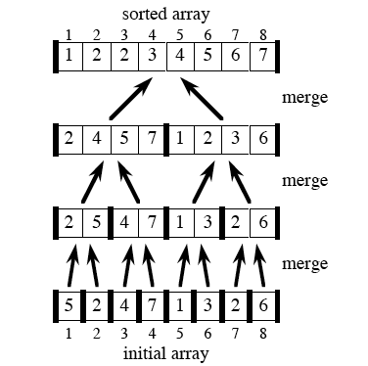
Example
Bottom-up view for n = 8

Slide 6
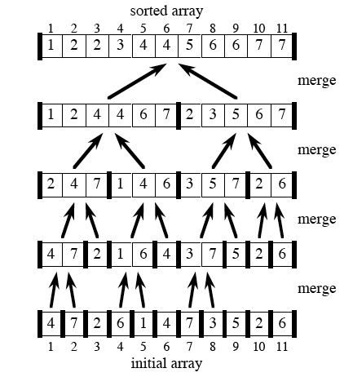
Example
Bottom-up view for n = 11

Slide 7
Merging
What remains is the MERGE procedure.
Input: Array A and indices p, q, r such that
p ≤ q < r.
Subarray A[p ..q] is sorted and subarray A[q + 1 ..r] is sorted. By the restrictions on p, q, r, neither subarray is empty.
Output: The two subarrays are merged into a single sorted subarray in A[p .. r].
We implement it so that it takes Θ(n) time, where n = r - p + 1 = the number of elements being merged.

Slide 8
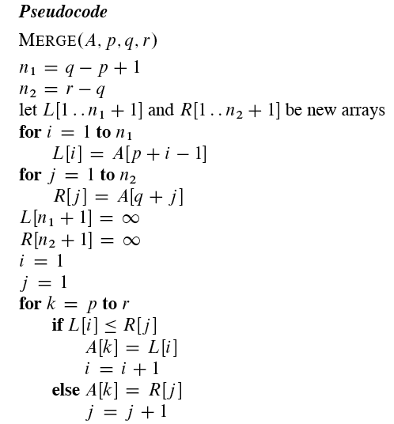
Merging

Slide 9
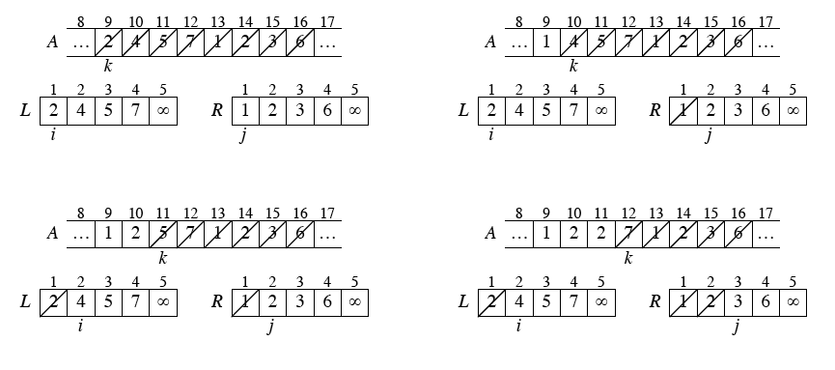
Example - A call of MERGE(9, 12, 16)

Slide 10
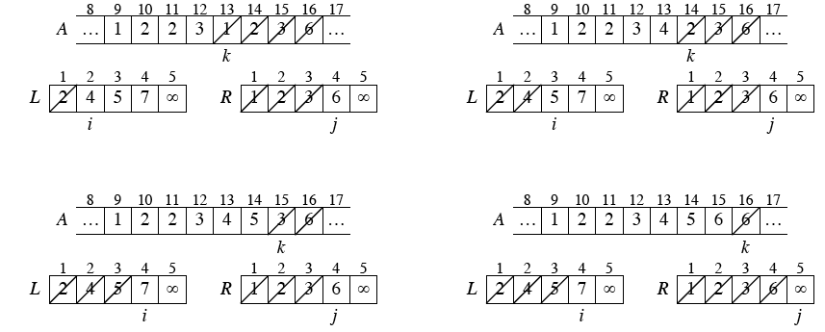
Example - A call of MERGE(9, 12, 16)

Slide 11
MERGE
Running time of MERGE
The first two for loops take Θ(n₁1 + n₂22) = Θ(n) time. The last for loop makes n iterations, each taking constant time, for Θ(n) time.
Total time: Θ(n).

Slide 12
Analyzing divide-and-conquer algorithms
Use a recurrence equation (more commonly, a recurrence) to describe the running time of a divide-and-conquer algorithm.
Let T(n) =running time on a problem of size n.
If the problem size is small enough (say, n ≤ c for some constant c), we have a base case. The brute-force solution takes constant time: Θ(1).
Otherwise, suppose that we divide into a subproblems, each 1/b the size of the original. (In merge sort, a =b = 2.)

Slide 13
Analyzing divide-and-conquer algorithms
Let the time to divide a size-n problem be D(n).
Have a subproblems to solve, each of size n/b ⇒ each subproblem takes T(n/b) time to solve ⇒ we spend aT(n/b) time solving subproblems.
Let the time to combine solutions be C(n).
We get the recurrence

Slide 14
Analyzing merge sort
For simplicity, assume that n is a power of 2 ⇒ each divide step yields two subproblems, both of size exactly n=2.
The base case occurs when n = 1.
When n ≥ 2, time for merge sort steps:
Divide: Just compute q as the average of p and r ⇒ D(n) = Θ(1).
Conquer: Recursively solve 2 subproblems, each of size n/2 ⇒ 2T(n/2).
Combine: MERGE on an n-element subarray takes Θ(n) time ⇒ C(n) = Θ(n).

Slide 15
Analyzing merge sort
Since D(n) = Θ(1) and C(n) = Θ(n), summed together they give a function that is linear in n: Θ(n) ⇒ recurrence for merge sort running time is

Slide 16
Solving the merge-sort recurrence
By the master theorem in Chapter 4, we can show that this recurrence has the solution T(n) =Θ(n lg n).
Compared to insertion sort Θ(n²) worst-case time), merge sort is faster.
On small inputs, insertion sort may be faster.
We can understand how to solve the merge-sort recurrence without the master theorem.

Slide 17
Solving the merge-sort recurrence
Let c be a constant that describes the running time for the base case and also is the time per array element for the divide and conquer steps.
We rewrite the recurrence as

Slide 18
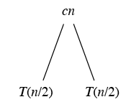
Solving the merge-sort recurrence
Draw a recursion tree, which shows successive expansions of the recurrence.
For the original problem, we have a cost of cn, plus the two subproblems, each costing T(n/2):

Slide 19
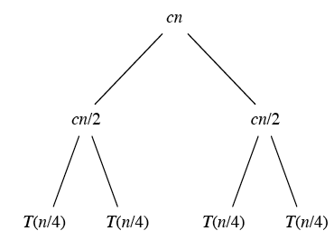
Solving the merge-sort recurrence
For each of the size-n/2 subproblems, we have a cost of cn=2, plus two subproblems, each costing T(n/4):

Slide 20
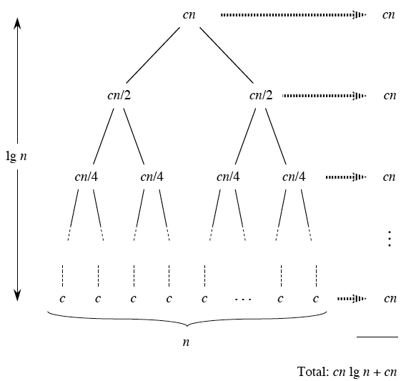
Solving the merge-sort recurrence
Continue expanding until the problem sizes get down to 1:

Slide 21
Solving the merge-sort recurrence
Each level has cost cn.
The top level has cost cn.
The next level down has 2 subproblems, each contributing cost cn/2.
…
There are lg n + 1 levels (height is lg n).
Use induction.
Base case: n = 1 ⇒ 1 level, and lg 1 = 1 + 0 + 1 = 1.
Inductive hypothesis is that a tree for a problem size of 2^{i} i I has lg 2^{i} + 1 = I + 1 levels.

Slide 22
Solving the merge-sort recurrence
Because we assume that the problem size is a power of 2, the next problem size up after 2^{i} is 2^{i+1}
A tree for a problem size of 2^{i+1} has has one more level than the size-2^{i} tree ⇒ i + 2 levels
Since lg 2^{i+1} + 1 = i + 2, we’re done with the inductive argument
Total cost is sum of costs at each level. Have lg n + 1 levels, each costing cn ⇒ total cost is cn lg n + cn.
Ignore low-order term of cn and constant coefficient c⇒ Θ(n lg n)

Slide 23
Solving the merge-sort recurrence
The computation:

Slide 24
Next Time
Growth of functions
Reading:
Read Chapter 3

