Slide 1
Growth of Functions
CS 46101 Section 600
CS 56101 Section 002
Dr. Angela Guercio
Spring 2010

Slide 2
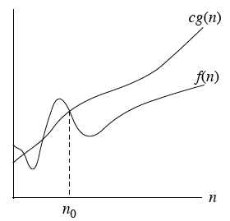
Asymptotic Notation
O-notation
O(g(n)) = { f(n): there exist positive constants c and n₀ such that 0 ≤ f(n) ≤ c g(n) for all n ≥ n₀ }.

Slide 3
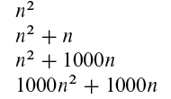
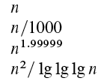
Asymptotic Notation
g(n) is an asymptotic upper bound for f(n)
If f(n) ∈O(g(n)), we write f(n) = O(g(n))
There is no claim how tight the upper bound is!
Example
2n² = O(n³) with c = 1 and n₀ = 2.
Examples of functions in O(n²)

Slide 4
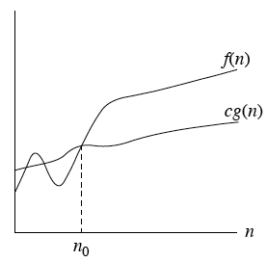
Ω-Notation
Ω(g(n)) = { f(n): there exist positive constants c and n₀ such that 0 ≤ c g(n) ≤ f(n) for all n ≥ n₀ }.

Slide 5
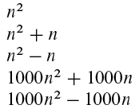
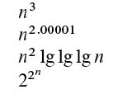
Ω-Notation
g(n) is an asymptotic lower bound for f(n).
Example
√n = Ω(lg n) with c = 1 and n₀ = 16.
Examples of functions in Ω(n²)

Slide 6
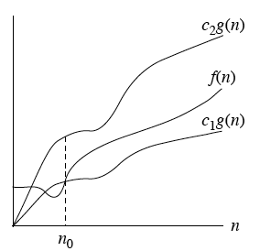
Θ-Notation
Θ-notation: Θ(g(n)) = { f(n): there exist positive constants c₁, c₂ and n₀ such that 0 ≤ c₁ g(n) ≤ f(n) ≤ c₂ g(n) for all n ≥ n₀ }.

Slide 7
Θ-Notation
g(n) is an asymptotically tight bound for f(n).
Example
½ n² - 3n = Θ(n²) with c₁ ≤ 1/14, c₂ = ½ and n₀ = 7.
½ n² - 3n ≤ c₂n² for c₂ = ½ is true for all n.
c₁n² ≤ ½ n² - 3n for c₁ = 1/14 is true for n=7
Remember that the constants MUST be positive
Theorem
For any two functions f(n) and g(n), f(n) = Θ(g(n)) if and only if f = O(g(n)) and f = Ω(g(n)).
Leading constants and low order terms don’t matter.
Ex. an²+bn+c= Θ(n²) for any constant a>0, b, and c implies that an²+bn+c= O(n²) and an²+bn+c= Ω (n²)

Slide 8
Asymptotic Notations in Equations
When on right-hand side
O(n²) stands for some function in the set O(n²).
2n² + 3n + 1 = 2n² + Θ(n) for some f(n) in Θ(n)
In particular f(n) = 3n + 1.
Ex. T(n)= T(n/2) + Θ(n)
When on left-hand side
No matter how the anonymous functions are chosen on the left-hand side, there is a way to choose the anonymous functions on the right-hand side to make the equation valid.
Ex. 2n² + Θ(n) = Θ(n²)

Slide 9
Asymptotic Notations in Equations
Interpret 2n² + Θ(n) = Θ(n²) as meaning for all functions f(n) ∈ Θ(n²) there exists a function g(n) ∈ Θ(n²) such that 2n² + f(n) = g(n).
Can chain together
2n² + 3n + 1 = 2n² + Θ(n)
= Θ(n²)

Slide 10
Asymptotic Notations in Equations
Interpretation
First equation: there exists f(n) ∈ Θ(n) such that 2n² + 3n + 1 = 2n² + f(n).
Second equation: For all g(n) ∈ Θ(n) (such as the f(n) used to make the first equation hold), there exists h(n) ∈ Θ(n²) such that 2n² + g(n) = h(n).

Slide 11
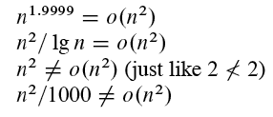
o-notation
O-notation may or may not be asymptotically tight
o-notation is NOT asymptotically tight
o(g(n)) = {f(n): for all constants c > 0, there exists a constant n₀ > 0 such that 0≤f(n)<cg(n) for all n ≥ n₀ .
Another view, probably easier to use:

Slide 12
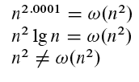
ω-notation
Analogously Ω-notation may or may not be asymptotically tight
ω-notation denotes a lower bound NOT asymptotically tight
ω(g(n))= {f(n): for all constants c > 0, there exists a constant n₀ > 0 such that 0≤cg(n)<f(n) for all n > n₀ }.
Another view, probably easier to use:

Slide 13
Comparisons of Functions
Relational properties
Transitivity
f(n) = Θ(g(n)) and g(n) = Θ(h(n)) ⇒ f(n) = Θ(h(n))
Same for O, Ω, o, and ω.
Reflexivity
f(n) = Θ(f(n))
Same for O, and Ω.
Symmetry
f(n) = Θ(g(n)) if and only if g(n) = Θ(f(n))
Transpose symmetry
f(n) = O(g(n)) if and only of g(n) = Ω (f(n))
f(n) = o(g(n)) if and only of g(n) = ω(f(n))

Slide 14
Comparisons of Functions
f(n) is asymptotically larger than g(n) if f(n) = ω(g(n))
f(n) is asymptotically smaller than g(n) if f(n) = o(g(n))
No trichotomy. Although intuitively we can liken O to ≤ and Ω to ≥, unlike real numbers where a < b, a = b, or a > b, we might not be able to compare functions
Example: n^{1+sin n} and n since 1 + sin n oscillates between 0 and 2.

Slide 15
Standard Notations and Common Functions
Monotonicity
f(n) is monotonically increasing if m ≤ n ⇒ f(m) ≤ f(n)
f(n) is monotonically decreasing if m ≥ n ⇒ f(m) ≥f(n)
f(n) is strictly increasing if m < n ⇒ f(m) < f(n)
f(n) is strictly decreasing if m > n ⇒ f(m) > f(n)

Slide 16
Standard Notations and Common Functions
Exponentials
Useful identities:
a⁻¹ = 1/a
(a^{m})^{n} = a^{mn}
a^{m}a^{n} = a^{m+n}
Can relate rates of growth of exponentials and polynomials: for all real constants a and b such that a > 1
Which implies that n^{b} = o(a^{n}).
For all real x, e^{x} ≥ 1 + x.

Slide 17
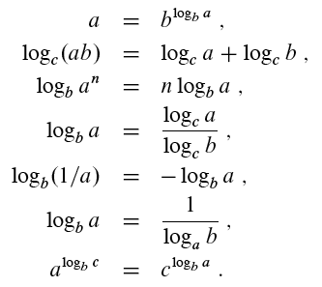
Standard Notations and Common Functions
Logarithms
lg n = log₂ n (binary logarithm).
ln n = log_{e} n (natural logarithm).
lg^{k} n = (lg n)^{k} (exponentiation).
lg lg n = lg(lg n) (composition).
Useful identities for all real a > 0, b > 0, c > 0 and logarithm bases not 0

Slide 18
Standard Notations and Common Functions
Factorials
n! = 1 ⋅ 2 ⋅ 3 ⋅ … ⋅ n
Special case 0! = 1.
A weak upper bound on the factorial is n! ≤n^{n} since the Stirling’s approximation says that
If n! ≤ n^{n} the lg(n!) ≤ lg n^{n} i.e. lg(n!) = Θ (n lg n).

Slide 19
Next Time
Divide and Conquer
Reading:
Read Chapter 4

