Slide 1
Divide-and-Conquer
CS 46101 Section 600
CS 56101 Section 002
Dr. Angela Guercio
Spring 2010

Slide 2
Analyzing Divide-and-Conquer Algorithms
Use a recurrence to characterize the running time of a divide-and-conquer algorithm.
Solving the recurrence gives us the asymptotic running time.
A recurrence is a function is defined in terms of
one or more base cases, and !
itself, with smaller arguments.

Slide 3
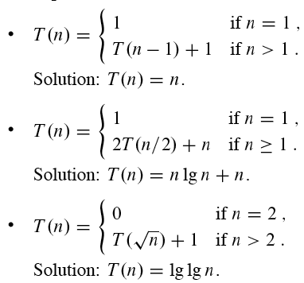
Analyzing Divide-and-Conquer Algorithms
Examples

Slide 4
Analyzing Divide-and-Conquer Algorithms
Many technical issues:
Floors and ceilings - ARE OMITTED
Boundary conditions - ARE OMITTED
Exact vs. asymptotic functions
In algorithm analysis, we usually express both the recurrence and its solution using asymptotic notation.
Example: T(n) = 2T(n/2) + Θ(n) with solution T(n) = Θ(n lg n).

Slide 5
Analyzing Divide-and-Conquer Algorithms
The boundary conditions are usually expressed as “T(n) = Θ(1) for sufficiently small n.”
When we desire an exact, rather than an asymptotic, solution, we need to deal with boundary conditions.
In practice, we just use asymptotic most of the time, and we ignore boundary conditions.

Slide 6
Maximum-Subarray Problem
Input: An array A[1..n] of numbers.
Output: Indices i and j such that A[i..j] has the greatest sum of any nonempty, contiguous subarray of A, along with the sum of the values in A[i..j].
Scenario
You have the prices that a stock traded at over a period of n consecutive days.
When should you have bought the stock? When should you have sold the stock?
Even though it’s in retrospect, you can yell at your stockbroker for not recommending these buy and sell dates.

Slide 7
Maximum-Subarray Problem
To convert to a maximum-subarray problem, let A[i] = (price after day i ) - (price after day (i -1)).
Then the nonempty, contiguous subarray with the greatest sum brackets the days that you should have held the stock.
If the maximum subarray is A[i..j], then should have bought just before day i (i.e., just after day i - 1) and sold just after day j .
Why do we need to find the maximum subarray? Why not just “buy low, sell high”?

Slide 8
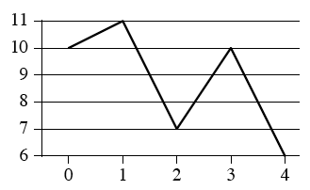
Maximum-Subarray Problem
Lowest price might occur after the highest price.
But wouldn’t the optimal strategy involve buying at the lowest price or selling at the highest price?
Not necessarily:
Maximum profit is $3 per share, from buying after day 2 and selling after day 3.
Yet lowest price occurs after day 4 and highest occurs after day 1.

Slide 9
Maximum-Subarray Problem
Can solve by brute force: check all Θ(n²) subarrays.
Can organize the computation so that each subarray A[i..j] takes O(1) time, given that you’ve computed A[i..j – 1], so that the brute-force solution takes Θ(n²) time.
Solving by divide-and-conquer
Use divide-and-conquer to solve in O(n lg n) time.
Subproblem: Find a maximum subarray of A[low..high].
In original call, low = 1, high = n.

Slide 10
Solving by divide-and-conquer
Divide the subarray into two subarrays of as equal size as possible. Find the midpoint mid of the subarrays, and consider the subarrays A[low..mid] and A[mid + 1..high].
Conquer by finding maximum subarrays of A[low..mid] and A[mid + 1..high].
Combine by finding a maximum subarray that crosses the midpoint, and using the best solution out of the three (the subarray crossing the midpoint and the two solutions found in the conquer step).
This strategy works because any subarray must either lie entirely on one side of the midpoint or cross the midpoint.

Slide 11
Solving by divide-and-conquer
Finding the maximum subarray that crosses the midpoint
Not a smaller instance of the original problem: has the added restriction that the subarray must cross the midpoint.
Again, could use brute force. If size of A[low..mid] is n, would have n/2 choices for left endpoint and n/2 choices for right endpoint, so would have Θ(n²) combinations altogether.
Can solve in linear time.

Slide 12
Solving by divide-and-conquer
Any subarray crossing the midpoint A[mid] is made of two subarrays A[i..mid] and A[mid + 1.. j], where low ≤ i ≤ mid and mid < j ≤ high.
Find maximum subarrays of the form A[i..mid] and A[mid + 1.. j] and then combine them.
Procedure to take array A and indices low, mid, high and return a tuple giving indices of maximum subarray that crosses the midpoint, along with the sum in this maximum subarray:

Slide 13
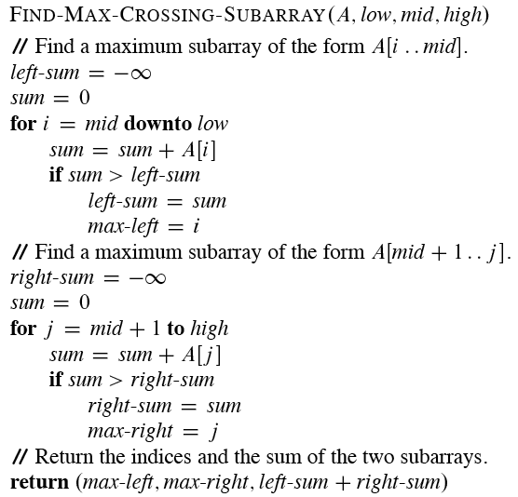
Solving by divide-and-conquer

Slide 14
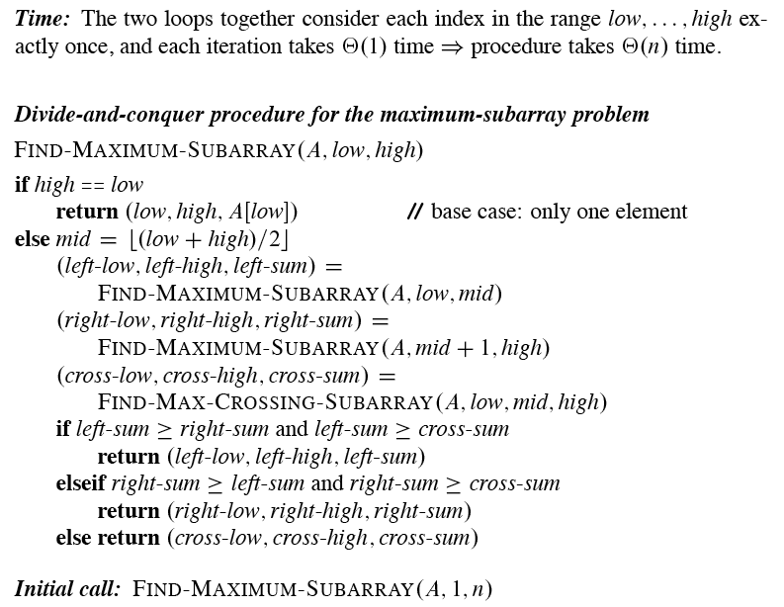

Slide 15
Solving by divide-and-conquer
Divide by computing mid.
Conquer by the two recursive calls to FIND-MAXIMUM-SUBARRAY.
Combine by calling FIND-MAX-CROSSING-SUBARRAY and then determining which of the three results gives the maximum sum.
Base case is when the subarray has only 1 element.

Slide 16
Analysis
Simplifying assumption: Original problem size is a power of 2, so that all subproblem sizes are integer.
Let T(n) denote the running time of FIND-MAXIMUM-SUBARRAY on a subarray of n elements.
Base case: Occurs when high equals low, so that n = 1. The procedure just returns ⇒ T(n) = Θ(1).

Slide 17
Analysis
Recursive case: Occurs when n > 1.
Dividing takes Θ(1) time.
Conquering solves two subproblems, each on a subarray of n / 2 elements. Takes T(n/2) time for each subproblem ⇒ 2T(n/2) time for conquering.
Combining consists of calling FIND-MAX-CROSSING-SUBARRAY, which takes Θ(n) time, and a constant number of constant-time tests ⇒Θ(n) + Θ(1) time for combining.

Slide 18
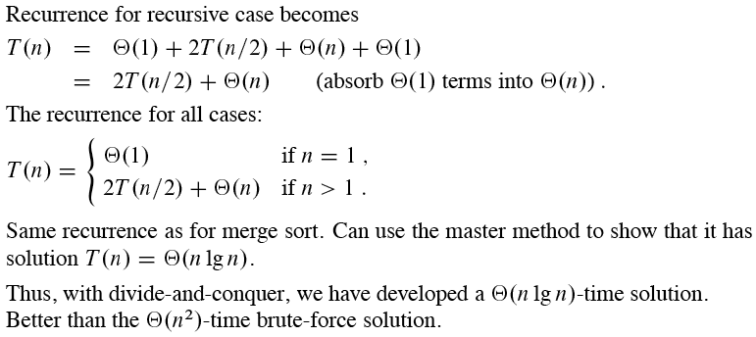
Analysis

Slide 19
Recurrence Relation Solution: 1) Substitution method
Guess the solution.
Use induction to find the constants and show that the solution works.
Example

Slide 20
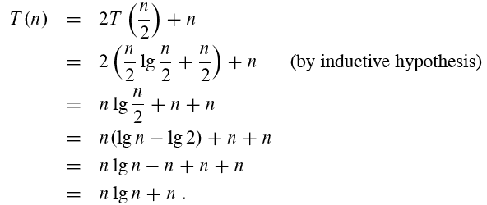
Substitution method
Guess: T(n) = n lg n + n.
Induction:
Basis: n =1 ⇒ n lg n + n = 1 = T(n)
Inductive step: Inductive hypothesis is that T(k) = k lg k + k for all k < n. We’ll use this inductive hypothesis for T(n / 2).

Slide 21
Substitution method
Generally, we use asymptotic notation:
We would write T(n) = 2T(n / 2) + Θ(n).
We assume T(n) = O(1) for sufficiently small n.
We express the solution by asymptotic notation: T(n) = Θ(n lg n).
We don’t worry about boundary cases, nor do we show base cases in the substitution proof.
T(n) is always constant for any constant n.
Since we are ultimately interested in an asymptotic solution to a recurrence, it will always be possible to choose base cases that work.
When we want an asymptotic solution to a recurrence, we don’t worry about the base cases in our proofs.
! When we want an exact solution, then we have to deal with base cases.

Slide 22
Substitution method
For the substitution method:
Name the constant in the additive term.
Show the upper (O) and lower (Ω) bounds separately. Might need to use different constants for each.
Example
T(n) = 2 T(n / 2) + Θ(n). If we want to show an upper bound of T(n) = 2 T(n / 2) + Θ(n), we write T(n) ≤ 2 T(n / 2) + cn for some positive constant c.

Slide 23
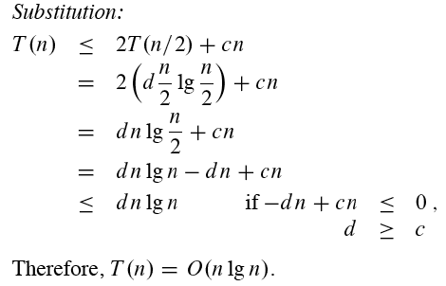
Substitution method
Upper bound:
Guess: T(n) ≤ d n lg n for some positive constant d. We are given c in the recurrence, and we get to choose d as any positive constant. It’s OK for d to depend on c.

Slide 24
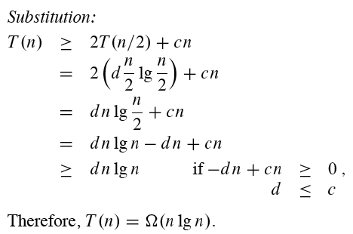
Substitution method
Lower bound: Write T(n) ≥ 2 T(n / 2) + cn for some positive constant c.
Guess: T(n) ≥ d n lg n for some positive constant d.
Therefore, T(n) = Θ(n lg n)

Slide 25
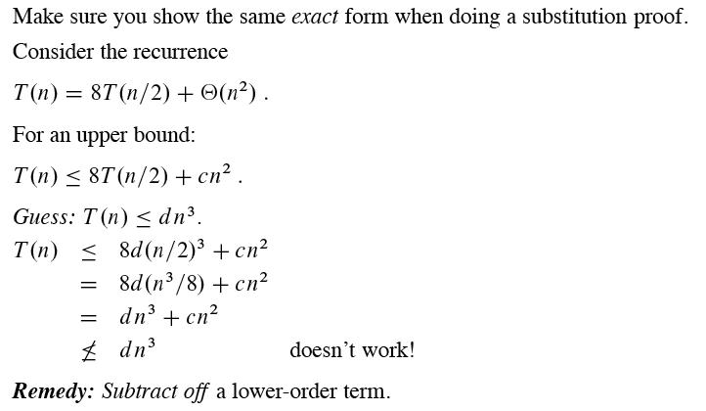
Substitution method

Slide 26
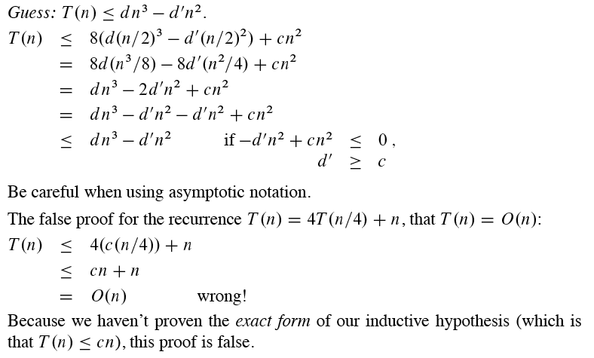
Substitution method

Slide 27
Next Time
More Divide and Conquer
Strassen’s algorithm for matrix multiplication
Reading:
Read Chapter 4

