Slide 1
Divide-and-Conquer
CS 46101 Section 600
CS 56101 Section 002
Dr. Angela Guercio
Spring 2010

Slide 2
Today
Strassen’s Algorithm for Matrix Multiplication
More on Recurrence Relations

Slide 3
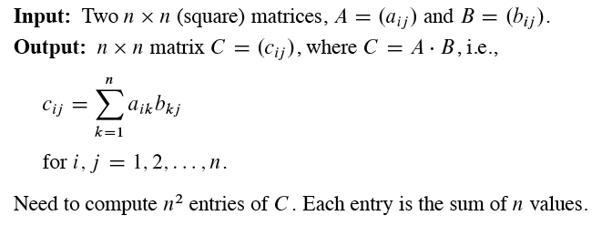
Strassen’s method for matrix multiplication

Slide 4
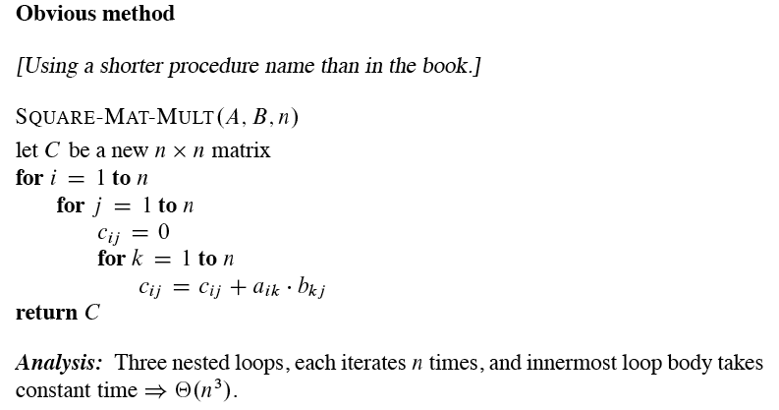
Strassen’s method for matrix multiplication

Slide 5
Strassen’s method for matrix multiplication
Is Θ(n³) the best we can do? Can we multiply matrices in o(n³)?
Seems like any algorithm to multiply matrices must take Ω(n³) time:
Must compute n² entries
Each entry is the sum of n terms
But with Strassen’s method we can multiply in o(n³)
Strassen’s method runs in Θ(n^{lg 7}) time.
2.80 ≤ lg 7 ≤ 2.81
Hence, runs in Θ(n^{2.81}) time

Slide 6
Simple divide-and-conquer method
As with the other divide-and-conquer algorithms, assume that n is a power of 2.
Partition each of A;B;C into four n/2 × n/2 matrices:
Rewrite C = A ⋅B as

Slide 7
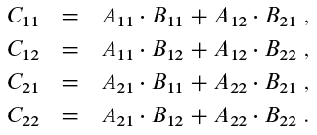
Simple divide-and-conquer method
giving the four equations
Each of these equations multiplies two n/2 × n/2 matrices and then adds their n/2 × n/2 products.
Use these equations to get a divide-and-conquer algorithm

Slide 8
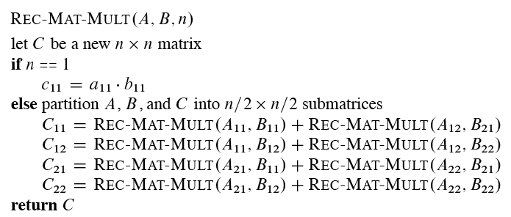
Simple divide-and-conquer method

Slide 9
Matrix Multiplication
Analysis
Let T(n) be the time to multiply two n/2 × n/2 matrices.
Best case: n = 1. Perform one scalar multiplication: Θ(1).
Recursive case: n > 1.
Dividing takes Θ(1) time using index calculations.
Conquering makes 8 recursive calls, each multiplying two n/2 × n/2 matrices ⇒ 8T(n/2).
Combining takes Θ(n²) time to add n/2 × n/2 matrices 4 times.

Slide 10
Matrix Multiplication
Recurrence is
Can use master method to show that it has solution T(n) = Θ(n³). Asymptotically, no better than the obvious method.

Slide 11
Matrix Multiplication
When setting up recurrences, can absorb constant factors into asymptotic notation, but cannot absorb a constant number of subproblems.
Although we absorb the 4 additions of n/2 × n/2 matrices into the Θ(n²) time we cannot lose the 8 in front of the T(n/2) term.
If we absorb the constant number of subproblems, then the recursion tree would not be “bushy” and would instead just be a linear chain.

Slide 12
Strassen’s Method
Idea: Make the recursion tree less bushy. Perform only 7 recursive multiplications of n/2 × n/2 matrices, rather than 8. Will cost several additions of n/2 × n/2 matrices, but just a constant number more ⇒ can still absorb the constant factor for matrix additions into the Θ(n²) term.

Slide 13
Strassen’s Method
Algorithm
As in the recursive method, partition each of the matrices into four n/2 × n/2 submatrices. Time: Θ(1).
Create 10 matrices S₁, S₂,…, S₁₀. Each is n/2 × n/2 and is the sum or difference of two matrices created in previous step. Time: Θ(n²) to create all 10 matrices.
Recursively compute 7 matrix products P₁, P₂,…, P₁₀ each n/2 × n/2.
Compute n/2 × n/2 submatrices of C by adding and subtracting various combinations of the P_{i}. Time: Θ(n²).

Slide 14
Strassen’s Method
Analysis:
Recurrence will be
By the master method, solution is T(n) = Θ(n^{lg 7}).

Slide 15
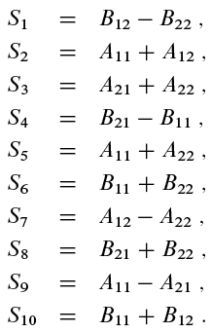
Details
Step 2, create the 10 matrices
Add or subtract n/2 × n/2 matrices 10 times ⇒ time is Θ(n / 2).

Slide 16
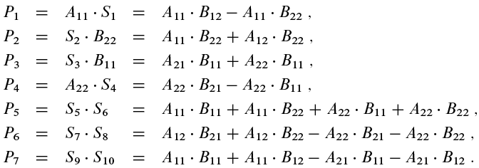
Details
Step 3, create the 7 matrices
The only multiplications needed are in the middle column; right-hand column just shows the products in terms of the original submatrices of A and B.

Slide 17
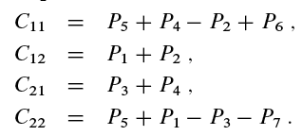
Details
Step 4, Add and subtract the P_{i} to construct submatrices of C:
To see how these computations work, expand each right-hand side, replacing each P_{i} with the submatrices of A and B that form it, and cancel terms:

Slide 18
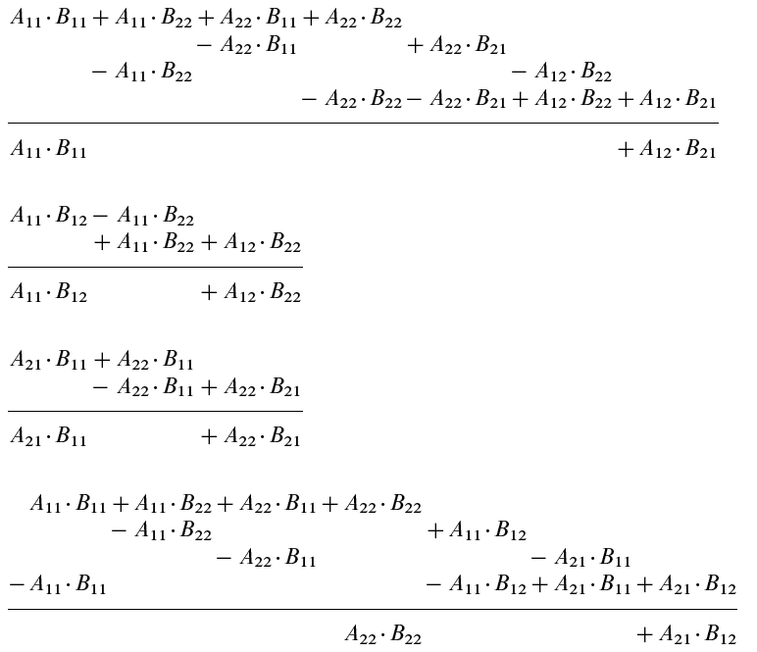
Details

Slide 19
Theoretical and practical notes
Strassen’s algorithm was the first to beat Θ(n³) time, but it’s not the asymptotically fastest known. A method by Coppersmith and Winograd runs in O(n^{2.376}) time.
Practical issues against Strassen’s algorithm:
Higher constant factor than the obvious Θ(n³)-time method.
Not good for sparse matrices.
Not numerically stable: larger errors accumulate than in the obvious method.
Submatrices consume space, especially if copying.
Crossover point somewhere between n = 8 and 400.

Slide 20
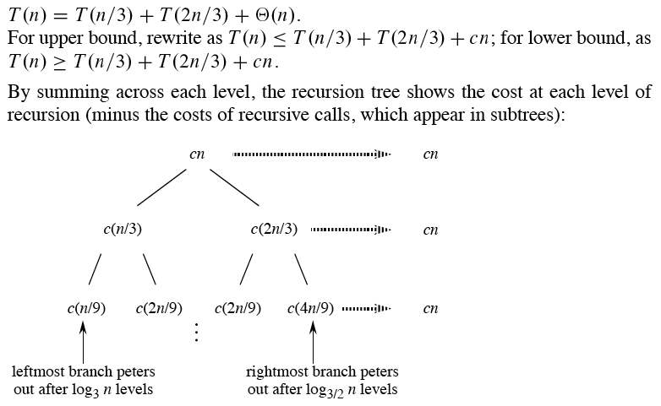
Recursion trees
Use to generate a guess. Then verify by substitution method.
Example:

Slide 21
Recursion trees
There are log₃n full levels, and after log_{3/2}n levels, the problem size is down to 1.
Each level contributes ≤ c n.
Lower bound guess: ≥ d n log₃n = Ω(n lg n) for some positive constant d.
Upper bound guess: ≤ d n log_{3/2}n = O(n lg n) for some positive constant d.
Then prove by substitution.

Slide 22
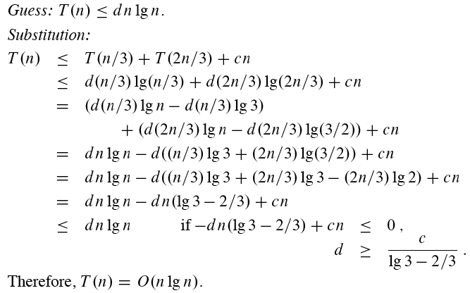
Recursion trees
Upper bound:

Slide 23
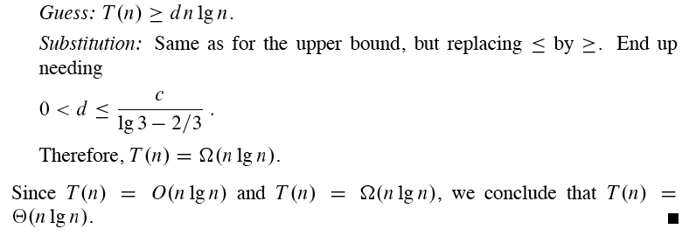
Recursion trees
Lower bound:

Slide 24
Master method
Used for many divide-and-conquer recurrences of the form
T(n) = aT(n/b) + f(n), where a ≥ 1, b > 1, f(n) > 0.
Based on the master theorem (Theorem 4.1).

Slide 25
Master method

Slide 26
Master method
The theorem does not cover all the cases
There is a gap between case 1 and case 2 when f(n) is smaller than n^{logba} but not polynomially smaller.
Similarly there is a gap between case 2 and case 3 when f(n) is larger than n^{logba} but not polynomially larger.

Slide 27
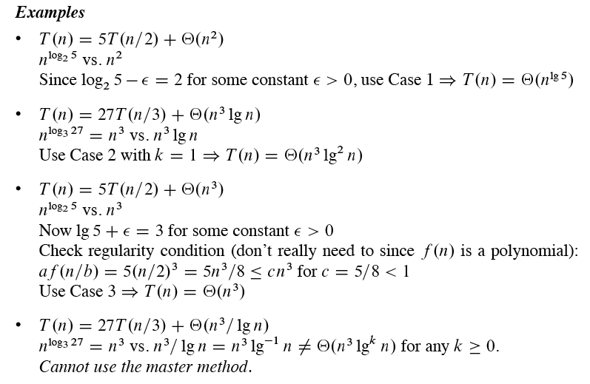
Master method

Slide 28
Next Time
Heapsort
Reading:
Read Chapter 7

