Slide 1
Heapsort
CS 46101 Section 600
CS 56101 Section 002
Dr. Angela Guercio
Spring 2010

Slide 2
Sorting
Insertion Sort
O(n²)
Mergesort
O(n lg n)

Slide 3
Overview
Heapsort
Sorts in place—like insertion sort.
O(n lg n) worst case—like merge sort.
Combines the best of both algorithms.
To understand heapsort, we’ll cover heaps and heap operations, and then we’ll take a look at priority queues.

Slide 4
Heap Data Structure
Heap A (not garbage-collected storage) is a nearly complete binary tree.
Height of node = # of edges on a longest simple path from the node down to a leaf.
Height of heap = height of root = Θ( lg n).
A heap can be stored as an array A.
Root of tree is A[1].
Parent of A[i] = A[floor(i / 2)].
Left child of A[i] = A[2i].
Right child of A[i] = A[2i + 1].
Computing is fast with binary representation implementation.

Slide 5
Example of a Max Heap

Slide 6
Heap property
For max-heaps (largest element at root), max-heap property: for all nodes i, excluding the root, A[PARENT(i)] ≥ A[i].
For min-heaps (smallest element at root), min-heap property: for all nodes i, excluding the root, A[PARENT(i)] ≤ A[i].
By induction and transitivity of ≥, the max-heap property guarantees that the maximum element of a max-heap is at the root. Similar argument for min-heaps.
The heapsort algorithm we’ll show uses max-heaps.

Slide 7
Maintaining the heap property
MAX-HEAPIFY is important for manipulating max-heaps. It is used to maintain the max-heap property.
Before MAX-HEAPIFY, A[i] may be smaller than its children.
Assume left and right subtrees of i are max-heaps.
After MAX-HEAPIFY, subtree rooted at i is a max-heap.

Slide 8
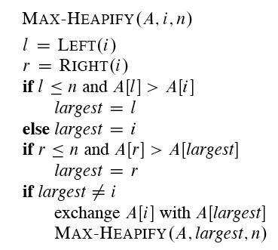
Maintaining the heap property

Slide 9
Maintaining the heap property
The way MAX-HEAPIFY works:
Compare A[i], A[LEFT(i)], and A[RIGHT(i)].
If necessary, swap A[i] with the larger of the two children to preserve heap property.
Continue this process of comparing and swapping down the heap, until subtree rooted at i is max-heap. If we hit a leaf, then the subtree rooted at the leaf is trivially a max-heap.

Slide 10
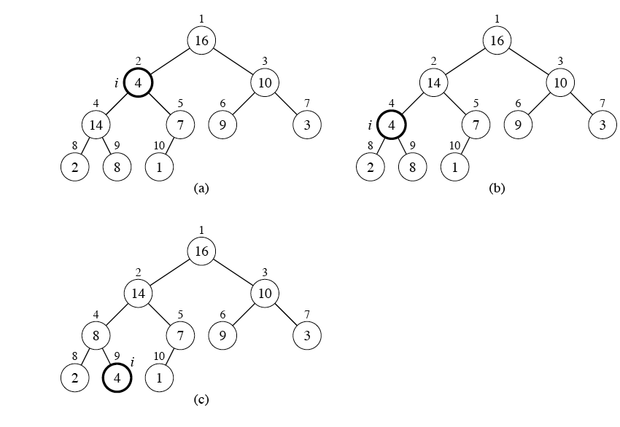
Example

Slide 11
Example
Node 2 violates the max-heap property.
Compare node 2 with its children, and then swap it with the larger of the two children.
Continue down the tree, swapping until the value is properly placed at the root of a subtree that is a max-heap. In this case, the max-heap is a leaf.
Time: O(lg n).
Analysis: Heap is almost-complete binary tree, hence must process O(lg n) levels, with constant work at each level (comparing 3 items and maybe swapping 2).

Slide 12
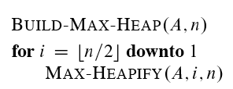
Building a heap
The following procedure, given an unordered array, will produce a max-heap.

Slide 13
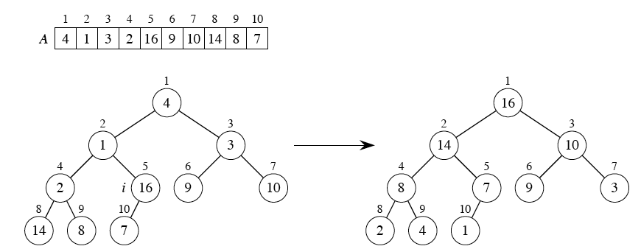
Example
Building a max-heap from the following unsorted array results in the first heap example.
i starts off as 5.
MAX-HEAPIFY is applied to subtrees rooted at nodes (in order): 16, 2, 3, 1, 4.

Slide 14
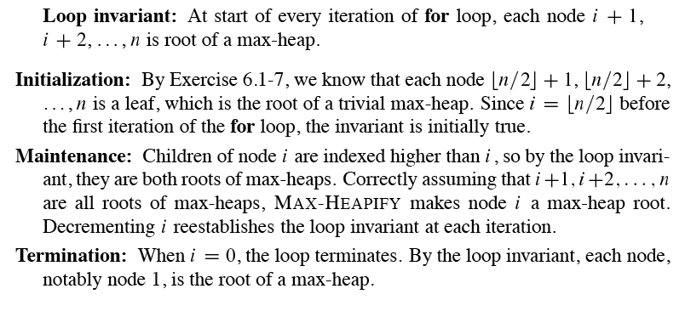
Correctness

Slide 15
Analysis
Simple bound: O(n) calls to MAX-HEAPIFY, each of which takes O(lg n) time ⇒ O(n lg n).
Tighter analysis: Observation: Time to run MAX-HEAPIFY is linear in the height of the node it’s run on, and most nodes have small heights. Have ≤ ceiling(n/2^{h+1}) nodes of height h (see Exercise 6.3-3), and height of heap is floor(lg n) (Exercise 6.1-2).

Slide 16
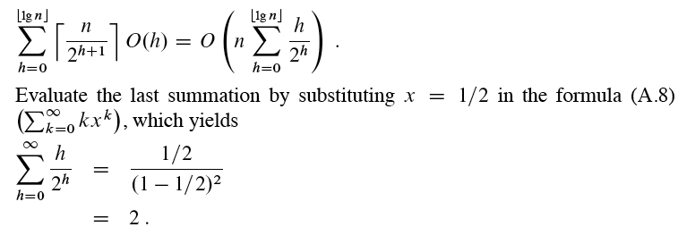
Analysis
The time required by MAX-HEAPIFY when called on a node of height h is O(h), so the total cost of BUILD-MAX-HEAP is
Thus, the running time of BUILD-MAX-HEAP is O(n).
Building a min-heap from an unordered array can be done by calling MINHEAPIFY instead of MAX-HEAPIFY, also taking linear time.

Slide 17
The heapsort algorithm
Given an input array, the heapsort algorithm acts as follows:
Builds a max-heap from the array.
Starting with the root (the maximum element), the algorithm places the maximum element into the correct place in the array by swapping it with the element in the last position in the array.
“Discard” this last node (knowing that it is in its correct place) by decreasing the heap size, and calling MAX-HEAPIFY on the new (possibly incorrectly-placed) root.
Repeat this “discarding” process until only one node (the smallest element) remains, and therefore is in the correct place in the array.

Slide 18
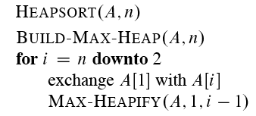
The heapsort algorithm

Slide 19
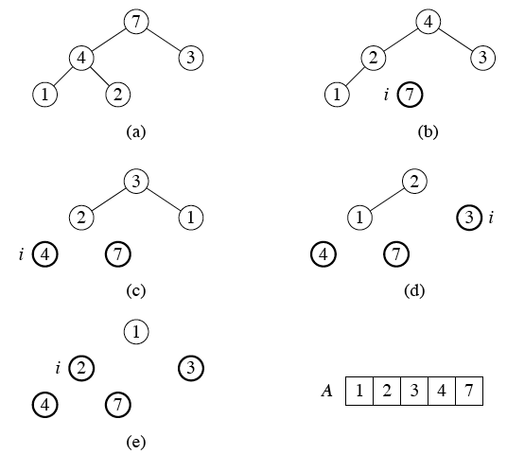
Example

Slide 20
Analysis
BUILD-MAX-HEAP: O(n)
for loop: n – 1 times
Exchange elements: O(1)
MAX-HEAPIFY: O(n lg n)
Total time: O(n lg n)
Though heapsort is a great algorithm, a well-implemented quicksort usually beats it in practice.

Slide 21
Heap implementation of priority queue
Heaps efficiently implement priority queues.
We look at maxpriority queues implemented with max-heaps.
Min-priority queues are implemented with min-heaps similarly.
A heap gives a good compromise between fast insertion but slow extraction and vice versa.
Both operations take O(n lg n) time.

Slide 22
Priority queue
Maintains a dynamic set S of elements.
Each set element has a key — an associated value.
Max-priority queue supports dynamic-set operations:
INSERT(S, x): inserts element x into set S.
MAXIMUM(S): returns element of S with largest key.
EXTRACT-MAX(S): removes and returns element of S with largest key.
INCREASE-KEY(S, x, k): increases value of element x’s key to k. Assume k ≥ x’s current key value.

Slide 23
Priority queue
Example max-priority queue application: schedule jobs on shared computer.
Min-priority queue supports similar operations:
INSERT(S, x): inserts element x into set S.
MINIMUM(S): returns element of S with smallest key.
EXTRACT-MIN(S): removes and returns element of S with smallest key.
DECREASE-KEY(S, x, k): decreases value of element x’s key to k. Assume k ≤ x’s current key value.

Slide 24
Priority queue
Note: Actual implementations often have a handle in each heap element that allows access to an object in the application, and objects in the application often have a handle (likely an array index) to access the heap element.
Will examine how to implement max-priority queue operations.

Slide 25
Finding the maximum element
Getting the maximum element is easy: it’s the root.
HEAP-MAXIMUM(A)
return A[1]
Time
Θ(1)

Slide 26
Extracting max element
Given the array A:
Make sure heap is not empty.
Make a copy of the maximum element (the root).
Make the last node in the tree the new root.
Re-heapify the heap, with one fewer node.
Return the copy of the maximum element.

Slide 27
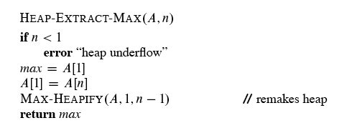
Extracting max element

Slide 28
Example
Run HEAP-EXTRACT-MAX on first heap example.
Take 16 out of node 1.
Move 1 from node 10 to node 1.
Erase node 10.
MAX-HEAPIFY from the root to preserve max-heap property.
Note that successive extractions will remove items in reverse sorted order.

Slide 29
Increasing key value
Given set S, element x, and new key value k:
Make sure k ≥ x’s current key.
Update x’s key value to k.
Traverse the tree upward comparing x to its parent and swapping keys if necessary, until x’s key is smaller than its parent’s key.

Slide 30
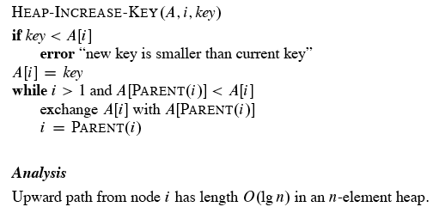
Increasing key value

Slide 31
Example
Increase key of node 9 in first heap example to have value 15. Exchange keys of nodes 4 and 9, then of nodes 2 and 4.

Slide 32
Inserting into the heap
Given a key k to insert into the heap:
Insert a new node in the very last position in the tree with key -∞.
Increase the -∞ key to k using the HEAP-INCREASE-KEY procedure defined above.

Slide 33
Inserting into the heap

