Slide 1
Quicksort
CS 46101 Section 600
CS 56101 Section 002
Dr. Angela Guercio
Spring 2010

Slide 2
Quicksort
Worst-case running time: Θ(n²).
Expected running time: Θ(n lg n).
Constants hidden in Θ(n lg n) are small.
Sorts in place.

Slide 3
Quicksort
Quicksort is based on the three-step process of divide-and-conquer.
To sort the subarray A[p .. r]:
Divide: Partition A[p .. r] into two (possibly empty) subarrays A[p .. q - 1] and A[q + 1 .. r] such that each element in the first subarray A[p .. q - 1] is ≤ A[q] and A[q] ≤ each element in the second subarray A[q + 1 .. r].
Conquer: Sort the two subarrays by recursive calls to QUICKSORT.
Combine: No work is needed to combine the subarrays, because they are sorted in place.

Slide 4
Quicksort
Perform the divide step by a procedure PARTITION, which returns the index q that marks the position separating the subarrays.
QUICKSORT(A, p, r)
if p < r
q = PARTITION(A, p, r)
QUICKSORT(A, p, q - 1)
QUICKSORT(A, q + 1, r)
Initial call is QUICKSORT(A, 1, n)

Slide 5
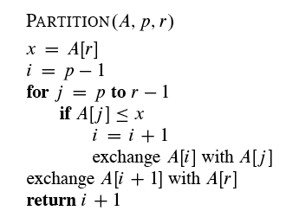
Partitioning
Partition subarray A[p .. r] by the following procedure

Slide 6
Partitioning
PARTITION always selects the last element A[r] in the subarray A[p .. r] as the pivot — the element around which to partition.
As the procedure executes, the array is partitioned into four regions, some of which may be empty:
Loop invariant:
All entries in A[p .. i] are ≤ pivot.
All entries in A[i + 1 .. j – 1] are > pivot.
A[r] = pivot.

Slide 7
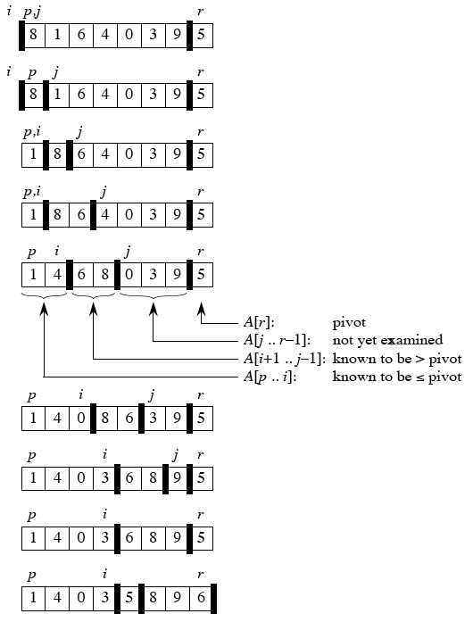
Example
On an 8-element
subarray

Slide 8
Correctness
Use the loop invariant to prove correctness of PARTITION:
Initialization: Before the loop starts, all the conditions of the loop invariant are satisfied, because r is the pivot and the subarrays A[p .. i] and A[i + 1 .. j – 1] are empty.
Maintenance: While the loop is running, if A[j] ≤ pivot then A[j] and A[i + 1] are swapped and then i and j are incremented. A[j] > pivot, then increment only j.
Termination: When the loop terminates, j = r, so all elements in A are partitioned into one of the three cases: A[p .. i] ≤ pivot, A[i + 1 .. r - 1] > pivot, and A[r] = pivot.

Slide 9
Correctness
The last two lines of PARTITION move the pivot element from the end of the array to between the two subarrays. This is done by swapping the pivot and the first element of the second subarray, i.e., by swapping A[i + 1] and A[r].
Time for partitioning
Θ(n) to partition an n-element subarray.

Slide 10
Performance of quicksort
The running time of quicksort depends on the partitioning of the subarrays:
If the subarrays are balanced, then quicksort can run as fast as mergesort.
If they are unbalanced, then quicksort can run as slowly as insertion sort.

Slide 11
Worst case
Occurs when the subarrays are completely unbalanced.
Have 0 elements in one subarray and n - 1 elements in the other subarray.
Get the recurrence
Same running time as insertion sort.
In fact, the worst-case running time occurs when quicksort takes a sorted array as input, but insertion sort runs in O(n) time in this case.

Slide 12
Best case
Occurs when the subarrays are completely balanced every time.
Each subarray has ≤ n / 2 elements.
Get the recurrence

Slide 13
Balanced partitioning
Quicksort’s average running time is much closer to the best case than to the worst case.
Imagine that PARTITION always produces a 9-to-1 split.
Get the recurrence

Slide 14
Balanced partitioning
Intuition: look at the recursion tree
It’s like the one for T(n) = T(n / 3) + T(2n / 3) + O(n) in Section 4.4.
Except that here the constants are different; we get log₁₀ n full levels and log_{10/9} n levels that are nonempty.
As long as it’s a constant, the base of the log doesn’t matter in asymptotic notation.
Any split of constant proportionality will yield a recursion tree of depth Θ(lg n).

Slide 15
Intuition for the average case
Splits in the recursion tree will not always be constant.
There will usually be a mix of good and bad splits throughout the recursion tree.
To see that this doesn’t affect the asymptotic running time of quicksort, assume that levels alternate between best-case and worst-case splits.

Slide 16
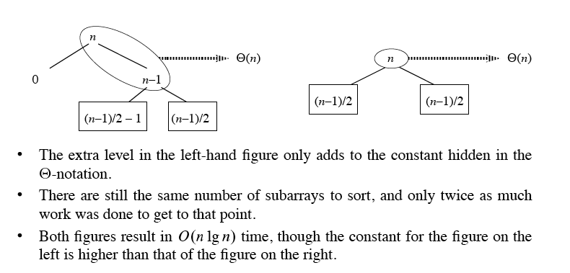
Intuition for the average case

Slide 17
Analysis of quicksort
Worst-case analysis
We will prove that a worst-case split at every level produces a worst-case running time of O(n²).
Recurrence for the worst-case running time of QUICKSORT:
Because PARTITION produces two subproblems, one of size n - 1, and one of size 1.
T(n) = T(n-1) + T(1) + Θ(n) =
T(n) = T(n-1) + Θ(n) since T(1) = Θ(1)
T(n) ≤ cn² for some c.

Slide 18
Next Time
Sorting in linear time
Counting Sort
Radix Sort
Reading
Chapter 7 until page 178

