Slide 1
Binary Search Trees
CS 46101 Section 600
CS 56101 Section 002
Dr. Angela Guercio
Spring 2010

Slide 2
Search trees
Data structures that support many dynamic-set operations.
Can be used as both a dictionary and as a priority queue.
Basic operations take time proportional to the height of the tree.
For complete binary tree with n nodes: worst case θ(lg n).
For linear chain of n nodes: worst case θ(n).
Different types of search trees include binary search trees, red-black trees (covered in Chapter 13), and B-trees (covered in Chapter 18).
We will cover binary search trees, tree walks, and operations on binary search trees.

Slide 3
Binary search trees
Binary search trees are an important data structure for dynamic sets.
Accomplish many dynamic-set operations in O(h) time, where h = height of tree.
As in Section 10.4, we represent a binary tree by a linked data structure in which each node is an object.
T.root points to the root of tree T .
Each node contains the attributes
key (and possibly other satellite data).
left: points to left child.
right: points to right child.
p: points to parent. T.root.p = NIL.
Stored keys must satisfy the binary-search-tree property.
If y is in left subtree of x, then y.key ≤ x.key.
If y is in right subtree of x, then y.key ≥ x.key.

Slide 4
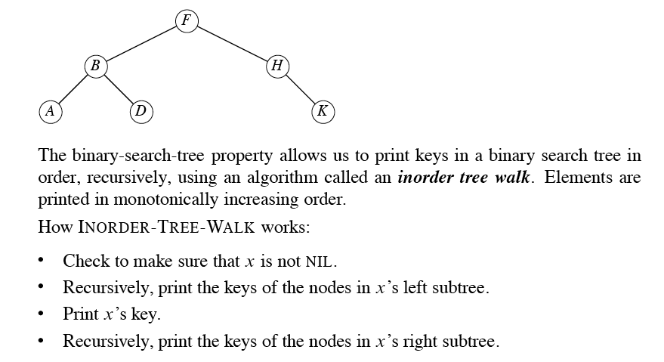
Binary search trees

Slide 5
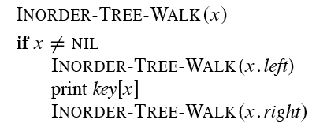
Binary search trees
Correctness: Follows by induction directly from the binary-search-tree property.
Time: Intuitively, the walk takes Θ(n) time for a tree with n nodes, because we visit and print each node once.

Slide 6
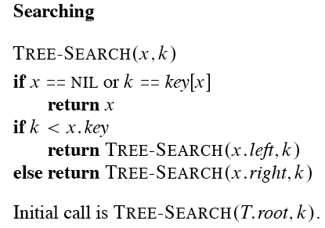
Querying a binary search tree
Time: The algorithm recursively, visits the nodes on a downward path from the root. Thus, running time is O(h), where h is the height of the tree.

Slide 7
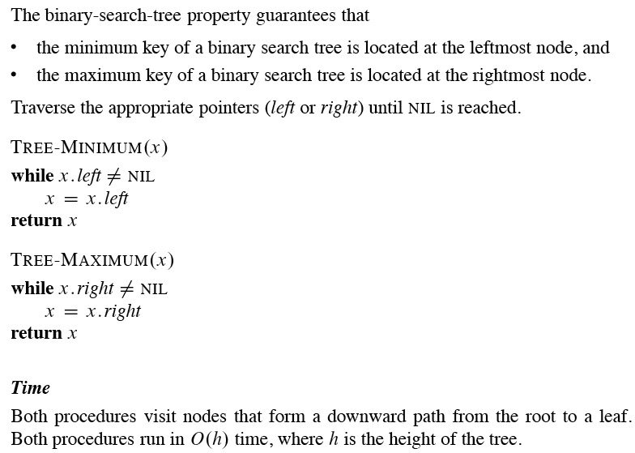
Maximum and minimum

Slide 8
Successor and predecessor
Assuming that all keys are distinct, the successor of a node x is the node y such that y.key is the smallest key > x.key. (We can find x’s successor based entirely on the tree structure. No key comparisons are necessary.) If x has the largest key in the binary search tree, then we say that x’s successor is NIL.
There are two cases:
If node x has a non-empty right subtree, then x’s successor is the minimum in x’s right subtree.
If node x has an empty right subtree, notice that:
As long as we move to the left up the tree (move up through right children), we’re visiting smaller keys.
x’s successor y is the node that x is the predecessor of (x is the maximum in y’s left subtree).

Slide 9
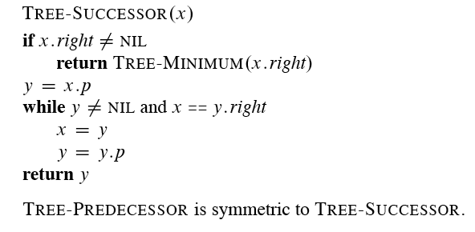
Successor and predecessor

Slide 10
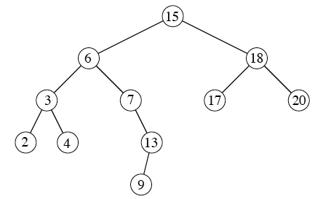
Example
Find the successor of the node with key value 15.
Find the successor of the node with key value 6.
Find the successor of the node with key value 4.
Find the predecessor of the node with key value 6.

Slide 11
Time
For both the TREE-SUCCESSOR and TREE-PREDECESSOR procedures, in both cases, we visit nodes on a path down the tree or up the tree. Thus, running time is O(h), where h is the height of the tree.

Slide 12
Insertion and deletion
Insertion and deletion allows the dynamic set represented by a binary search tree to change. The binary-search-tree property must hold after the change. Insertion is more straightforward than deletion.

Slide 13
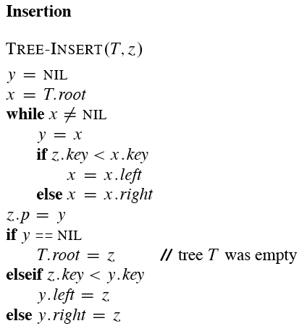
Insertion and deletion

Slide 14
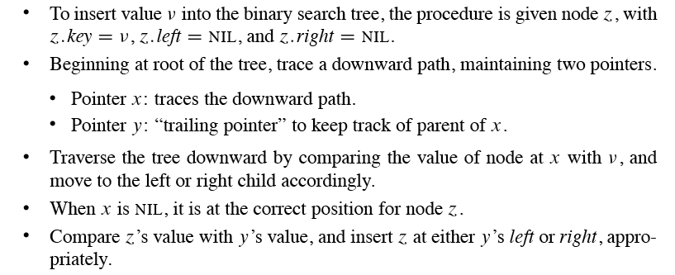
Insertion and deletion

Slide 15
Example
Run TREE-INSERT(T, z) several time to create the binary search tree.
TREE-INSERT(T, z) is called on each symbol of this string: F B H A D K C

Slide 16
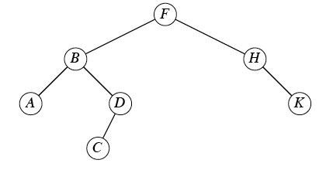
Example
Result

Slide 17
Time
Same as TREE-SEARCH. On a tree of height h, procedure takes O(h) time.
TREE-INSERT can be used with INORDER-TREE-WALK to sort a given set of numbers.

Slide 18
Deletion
Conceptually, deleting node z from binary search tree T has three cases:
If z has no children, just remove it.
If z has just one child, then make that child take z’s position in the tree, dragging the child’s subtree along.
If z has two children, then find z’s successor y and replace z by y in the tree. y must be in z’s right subtree and have no left child. The rest of z’s original right subtree becomes y’s new right subtree, and z’s left subtree becomes y’s new left subtree.
This case is a little tricky because the exact sequence of steps taken depends on whether y is z’s right child.

Slide 19
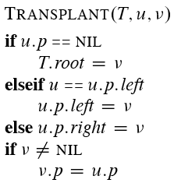
Deletion
The code organizes the cases a bit differently. Since it will move subtrees around within the binary search tree, it uses a subroutine, TRANSPLANT, to replace one subtree as the child of its parent by another subtree.

Slide 20
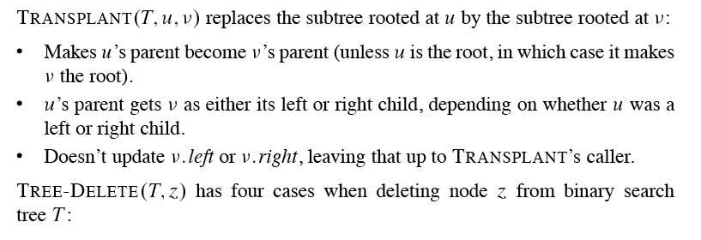
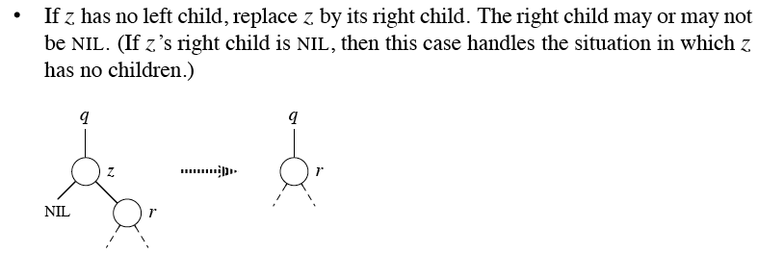
Deletion

Slide 21
Deletion

Slide 22
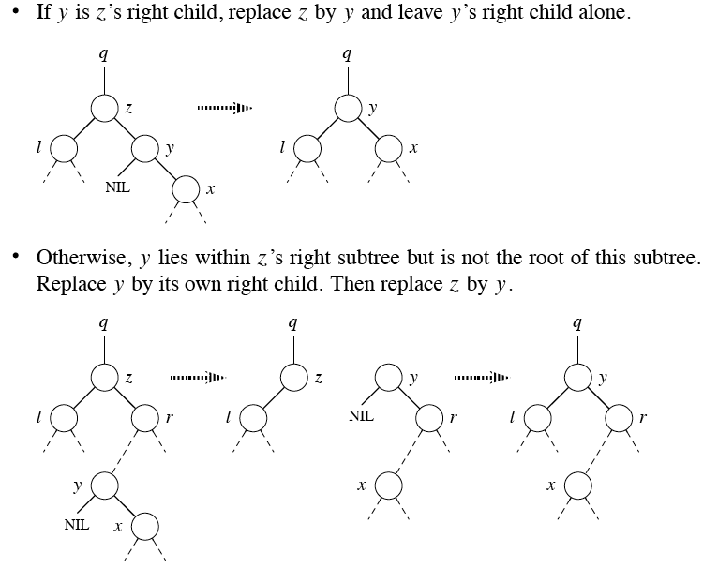
Deletion

Slide 23
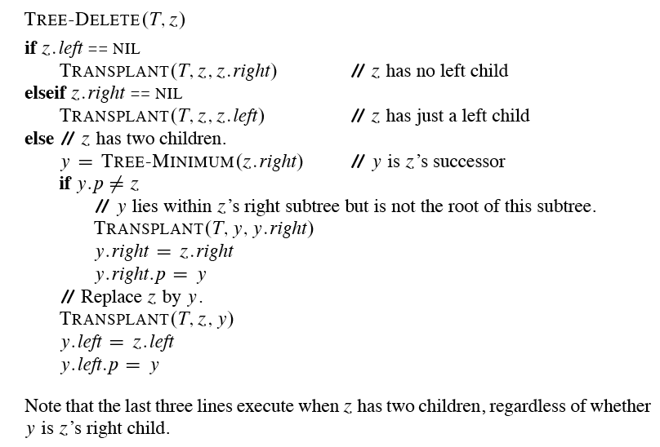
Deletion

Slide 24
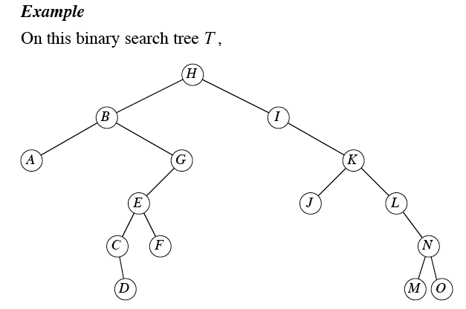
Example

Slide 25
Example

Slide 26
Time
O(h), on a tree of height h. Everything is O(1) except for the call to TREEMINIMUM.

Slide 27
Minimizing running time
We’ve been analyzing running time in terms of h (the height of the binary search tree), instead of n (the number of nodes in the tree).
Problem: Worst case for binary search tree is Θ(n)—no better than linked list.
Solution: Guarantee small height (balanced tree) — h = O(lg n).
In later chapters, by varying the properties of binary search trees, we will be able to analyze running time in terms of n.
Method: Restructure the tree if necessary. Nothing special is required for querying, but there may be extra work when changing the structure of the tree (inserting or deleting).
Red-black trees are a special class of binary trees that avoids the worst-case behavior of O(n) that we can see in “plain” binary search trees. Red-black trees are covered in detail in Chapter 13.

Slide 28
Next
Red and Black Trees

