Slide 1
Red-Black Trees
CS 46101 Section 600
CS 56101 Section 002
Dr. Angela Guercio
Spring 2010

Slide 2
Red-black trees
A variation of binary search trees.
Balanced: height is O(lg n), where n is the number of nodes.
Operations will take O(lg n) time in the worst case.

Slide 3
Red-black trees
A red-black tree is a binary search tree + 1 bit per node: an attribute color, which is either red or black.
All leaves are empty (nil) and colored black.
We use a single sentinel, T.nil, for all the leaves of red-black tree T .
T.nil.color is black.
The root’s parent is also T.nil.
All other attributes of binary search trees are inherited by red-black trees (key, left,right, and p). We don’t care about the key in T.nil.

Slide 4
Red-black properties
Every node is either red or black.
The root is black.
Every leaf (T.nil) is black.
If a node is red, then both its children are black. (Hence no two reds in a row on a simple path from the root to a leaf.)
For each node, all paths from the node to descendant leaves contain the same number of black nodes.

Slide 5
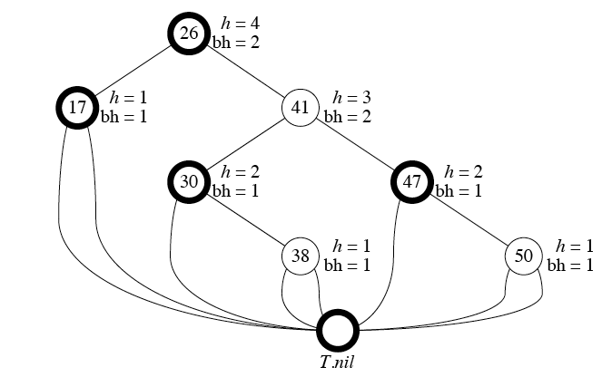
Example

Slide 6
Height of a red-black tree
Height of a node is the number of edges in a longest path to a leaf.
Black-height of a node x: bh(x) is the number of black nodes (including T.nil) on the path from x to leaf, not counting x. By property 5, black-height is well defined.

Slide 7
Height of a red-black tree
Claim
Any node with height h has black-height ≥ h/2.
Proof By property 4, ≤ h/2 nodes on the path from the node to a leaf are red.
Hence ≥ h/2 are black.

Slide 8
Height of a red-black tree
Claim
The subtree rooted at any node x contains ≥ 2^{bh(x)} - 1 internal nodes.
Proof By induction on height of x.
Basis: Height of x = 0 ⇒ x is a leaf ⇒ bh(x) = 0. The subtree rooted at x has 0 internal nodes. 2⁰ - 1 = 0.
Inductive step: Let the height of x be h and bh(x) = b. Any child of x has height h - 1 and black-height either b (if the child is red) or b -1 (if the child is black). By the inductive hypothesis, each child has ≥ 2^{bh(x) - 1} - 1 internal nodes. Thus, the subtree rooted at x contains ≥ 2 ∙ (2^{bh(x) - 1} - 1) + 1 internal nodes. (The +1 is for x itself.)

Slide 9
Height of a red-black tree
Lemma
A red-black tree with n internal nodes has height ≤ 2 lg(n + 1).
Proof Let h and b be the height and black-height of the root, respectively. By the above two claims, n ≥ 2^{b} - 1 ≥ 2^{h/2} – 1.
Adding 1 to both sides and then taking logs gives lg(n + 1) ≥ h/2, which implies that h ≤ 2 lg(n +1).

Slide 10
Operations on red-black trees
The non-modifying binary-search-tree operations MINIMUM, MAXIMUM, SUCCESSOR, PREDECESSOR, and SEARCH run in O(height) time. Thus, they take O(lg n) time on red-black trees.
Insertion and deletion are not so easy.
If we insert, what color to make the new node?
Red? Might violate property 4.
Black? Might violate property 5.
If we delete, thus removing a node, what color was the node that was removed?
Red? OK, since we won’t have changed any black-heights, nor will we have created two red nodes in a row. Also, cannot cause a violation of property 2, since if the removed node was red, it could not have been the root.
Black? Could cause there to be two reds in a row (violating property 4), and can also cause a violation of property 5. Could also cause a violation of property 2, if the removed node was the root and its child — which becomes the new root — was red.

Slide 11
Rotations
The basic tree-restructuring operation.
Needed to maintain red-black trees as balanced binary search trees.
Changes the local pointer structure. (Only pointers are changed.)
Won’t upset the binary-search-tree property.
Have both left rotation and right rotation. They are inverses of each other.
A rotation takes a red-black-tree and a node within the tree

Slide 12
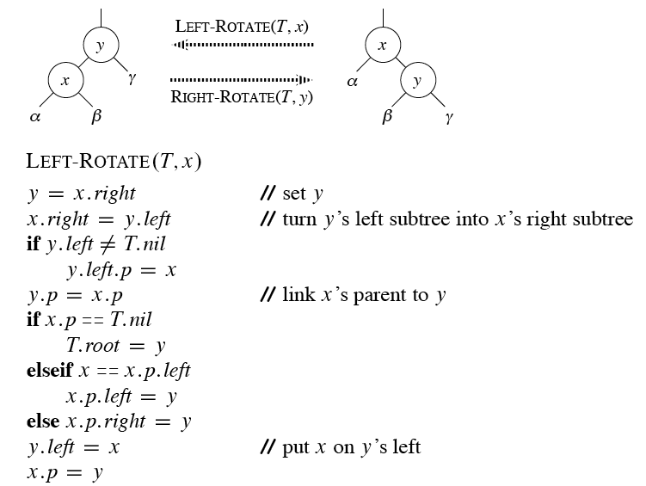
Rotations

Slide 13
Rotations
The pseudocode for LEFT-ROTATE assumes that
x.right ≠ T.nil, and
root’s parent is T.nil.
Pseudocode for RIGHT-ROTATE is symmetric: exchange left and right everywhere.

Slide 14
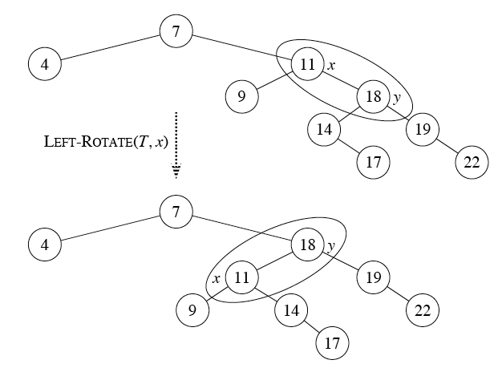
Example

Slide 15
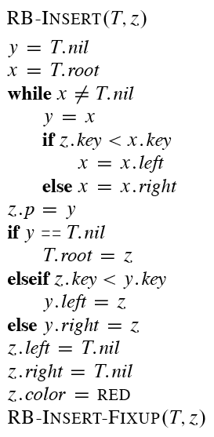
Insertion

Slide 16
Insertion
RB-INSERT ends by coloring the new node z red.
Then it calls RB-INSERT-FIXUP because we could have violated a red-black property.
Which property might be violated?
OK.
If z is the root, then there’s a violation. Otherwise, OK.
OK.
If z.p is red, there’s a violation: both z and z.p are red.
OK.

Slide 17
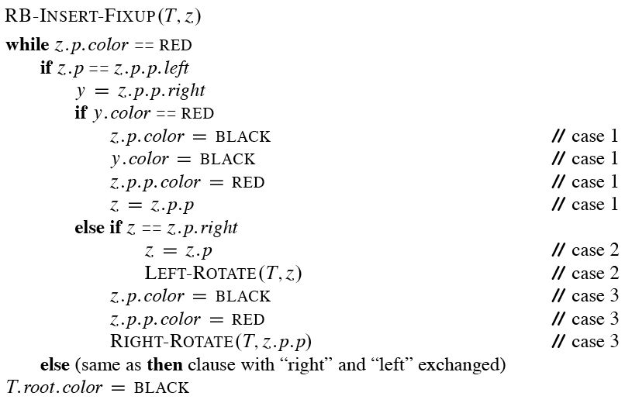
Insertion

Slide 18
Insertion
Loop invariant:
At the start of each iteration of the while loop,
z is red.
There is at most one red-black violation:
Property 2: z is a red root, or
Property 4: z and z.p are both red.

Slide 19
Insertion
Initialization: We’ve already seen why the loop invariant holds initially.
Termination: The loop terminates because z.p is black. Hence, property 4 is OK. Only property 2 might be violated, and the last line fixes it.
Maintenance: We drop out when z is the root (since then z.p is the sentinel T.nil, which is black). When we start the loop body, the only violation is of property 4.
There are 6 cases, 3 of which are symmetric to the other 3. The cases are not mutually exclusive. We’ll consider cases in which z.p is a left child.
Let y be z’s uncle (z.p’s sibling).

Slide 20
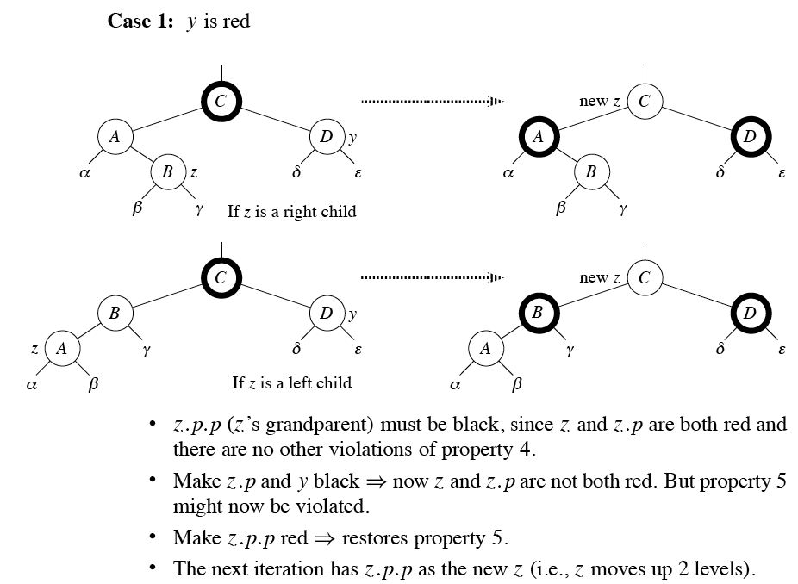
Loop invariant

Slide 21
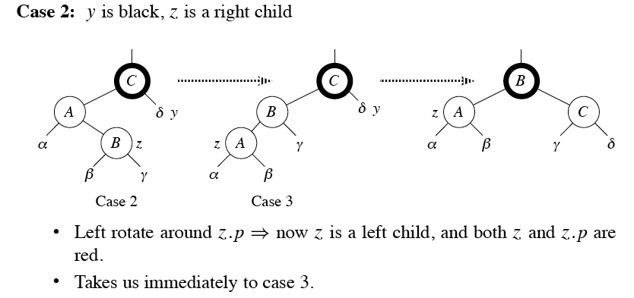
Loop invariant

Slide 22
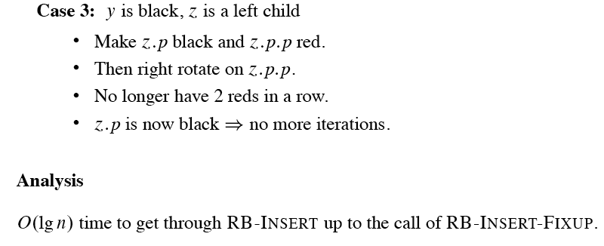
Loop invariant

Slide 23
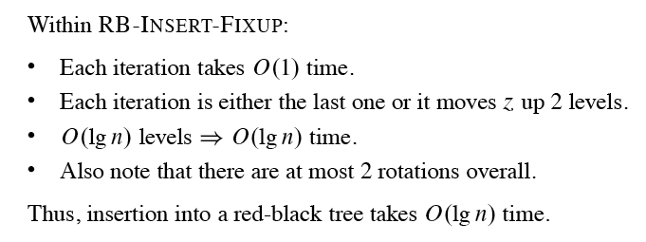
Analysis

Slide 24
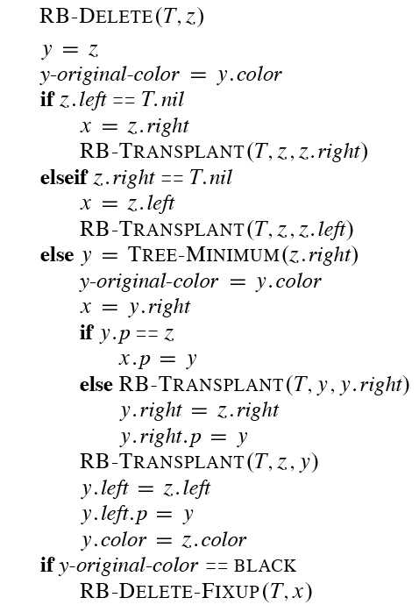
Deletion

Slide 25
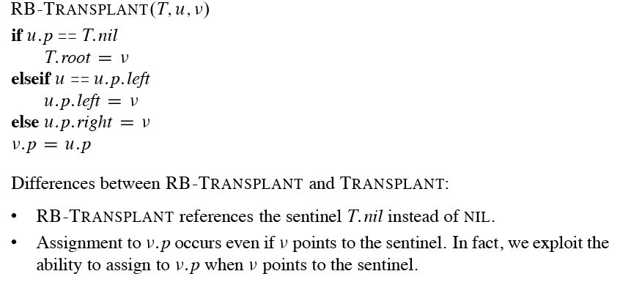
Deletion

Slide 26
Deletion
Differences between RB-TRANSPLANT and TRANSPLANT:
RB-TRANSPLANT references the sentinel T.nil instead of NIL.
Assignment to v.p occurs even if v points to the sentinel. In fact, we exploit the ability to assign to v.p when v points to the sentinel.
RB-DELETE has almost twice as many lines as TREE-DELETE, but you can find each line of TREE-DELETE within RB-DELETE (with NIL replaced by T.nil and calls to TRANSPLANT replaced by calls to RB-TRANSPLANT).

Slide 27
Differences between RB-DELETE and TREE-DELETE
y is the node either removed from the tree (when z has fewer than 2 children) or moved within the tree (when z has 2 children).
Need to save y’s original color (in y-original-color) to test it at the end, because if it’s black, then removing or moving y could cause red-black properties to be violated.
x is the node that moves into y’s original position. It’s either y’s only child, or T.nil if y has no children.
Sets x.p to point to the original position of y’s parent, even if x = T.nil. x.p is set in one of two ways:
If z is not y’s original parent, x.p is set in the last line of RB-TRANSPLANT.
If z is y’s original parent, then y will move up to take z’s position in the tree. The assignment x.p = y makes x.p point to the original position of y’s parent, even if x is T.nil.
If y’s original color was black, the changes to the tree structure might cause red-black properties to be violated, and we call RB-DELETE-FIXUP at the end to resolve the violations.

Slide 28
Differences between RB-DELETE and TREE-DELETE
If y was originally black, what violations of red-black properties could arise?
No violation.
If y is the root and x is red, then the root has become red.
No violation.
Violation if x.p and x are both red.
Any simple path containing y now has 1 fewer black node.
Correct by giving x an “extra black.”
Add 1 to count of black nodes on paths containing x.
Now property 5 is OK, but property 1 is not.
x is either doubly black (if x.color = BLACK) or red & black (if x.color = RED)
! The attribute x.color is still either RED or BLACK. No new values for color attribute.
! In other words, the extra blackness on a node is by virtue of x pointing to the node.

Slide 29
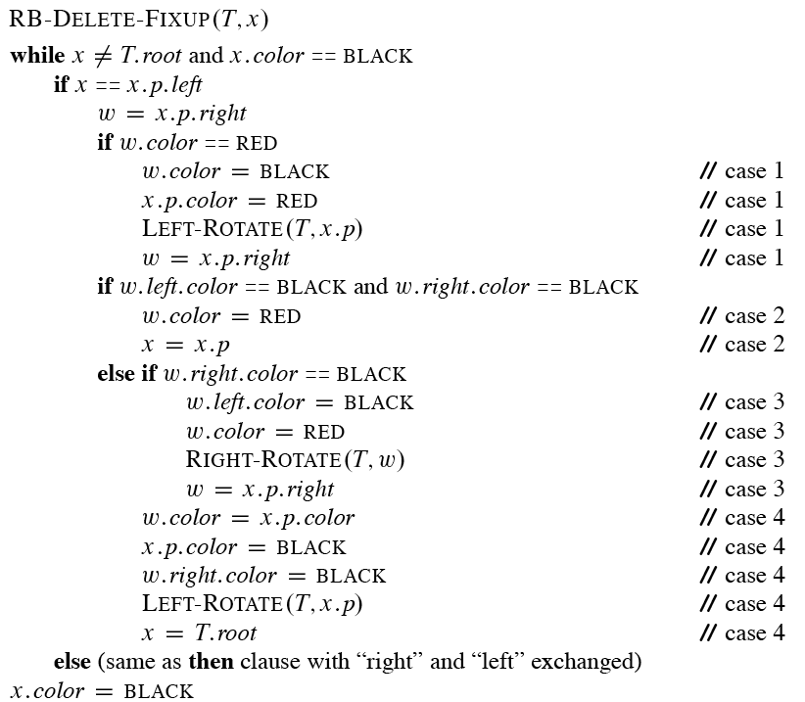
Remove the violations by calling RB-DELETE-FIXUP:

Slide 30
Idea
Move the extra black up the tree until
x points to a red & black node ⇒ turn it into a black node,
x points to the root ⇒ just remove the extra black, or
we can do certain rotations and recolorings and finish.
Within the while loop:
x always points to a nonroot doubly black node.
w is x’s sibling.
w cannot be T.nil, since that would violate property 5 at x.p.
There are 8 cases, 4 of which are symmetric to the other 4. As with insertion, the cases are not mutually exclusive. We’ll look at cases in which x is a left child.

Slide 31
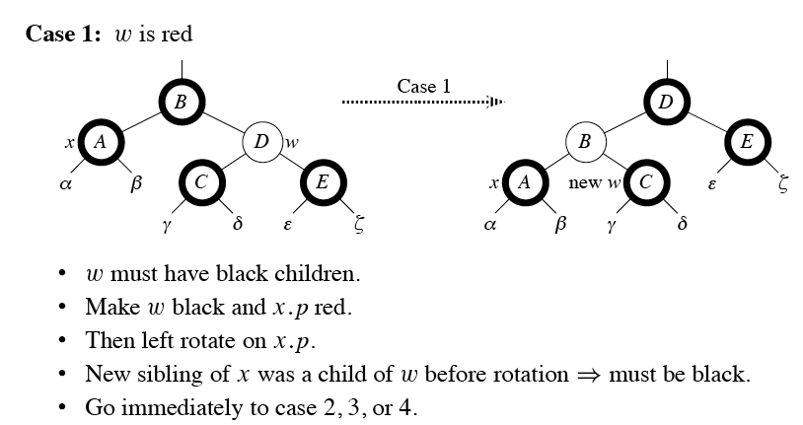
Case 1

Slide 32
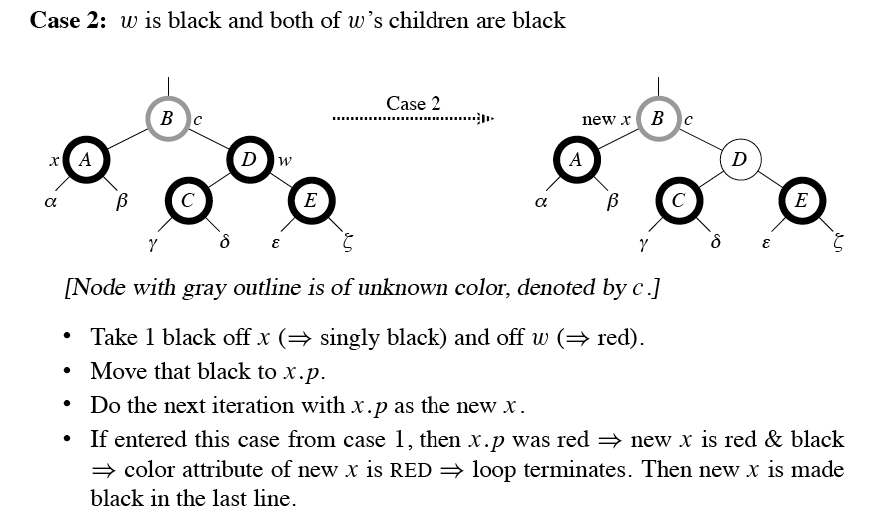
Case 2

Slide 33
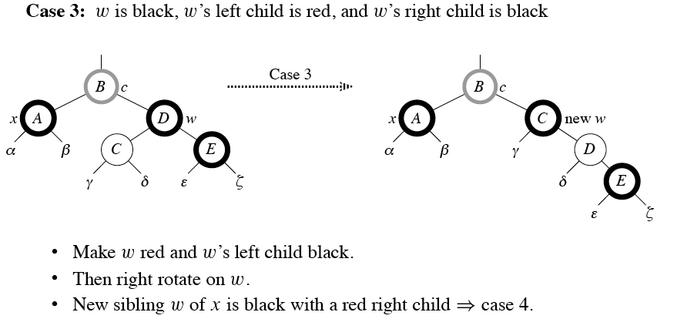
Case 3

Slide 34
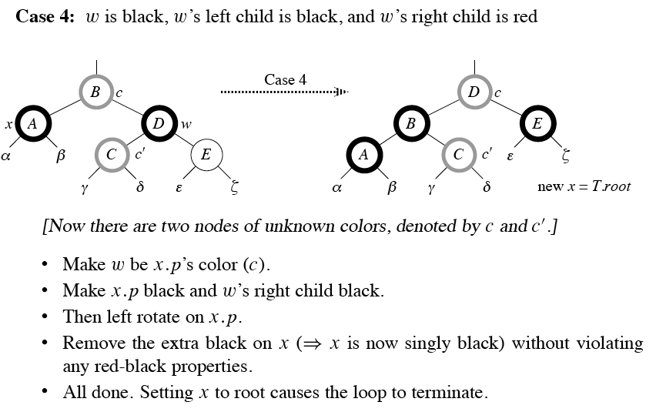
Case 4

Slide 35
Analysis
O(lg n) time to get through RB-DELETE up to the call of RB-DELETE-FIXUP.
Within RB-DELETE-FIXUP:
Case 2 is the only case in which more iterations occur.
x moves up 1 level.
Hence, O(lg n) iterations.
Each of cases 1, 3, and 4 has 1 rotation ⇒ ≤ 3 rotations in all.
Hence, O(lg n) time.

