Slide 1
Elementary Graph Algorithms
CS 46101 Section 600
CS 56101 Section 002
Dr. Angela Guercio
Spring 2010

Slide 2
Graph representation
Given graph G = (V, E). In pseudocode, represent vertex set by G.V and edge set by G.E.
G may be either directed or undirected.
Two common ways to represent graphs for algorithms:
1. Adjacency lists.
2. Adjacency matrix.
When expressing the running time of an algorithm, it’s often in terms of both |V| and |E|. In asymptotic notation - and only in asymptotic notation – we’ll often drop the cardinality. Example O(V + E).

Slide 3
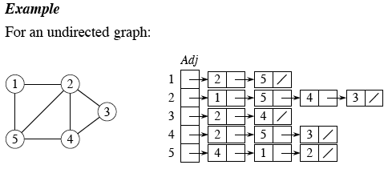
Adjacency lists
Array Adj of |V| lists, one per vertex.
Vertex u’s list has all vertices v such that (u, v) ∈ E. (Works for both directed and undirected graphs.)
In pseudocode, denote the array as attribute G.Adj, so will see notation such as G.Adj[u].

Slide 4
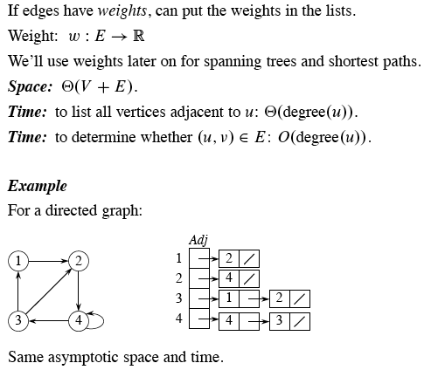
Adjacency lists

Slide 5
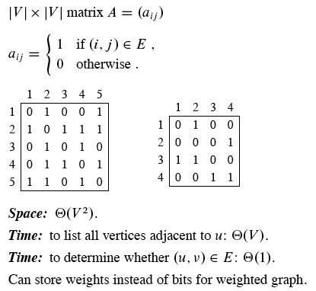
Adjacency Matrix

Slide 6
Representing graph attributes
Graph algorithms usually need to maintain attributes for vertices and/or edges. Use the usual dot-notation: denote attribute d of vertex v by v.d.
Use the dot-notation for edges, too: denote attribute f of edge (u, v) by (u, v).f.

Slide 7
Implementing graph attributes
No one best way to implement. Depends on the programming language, the algorithm, and how the rest of the program interacts with the graph.
If representing the graph with adjacency lists, can represent vertex attributes in additional arrays that parallel the Adj array, e.g., d[1 . . |V|], so that if vertices adjacent to u are in Adj[u], store u.d in array entry d[u].
But can represent attributes in other ways. Example: represent vertex attributes as instance variables within a subclass of a Vertex class.

Slide 8
Breadth-first search

Slide 9
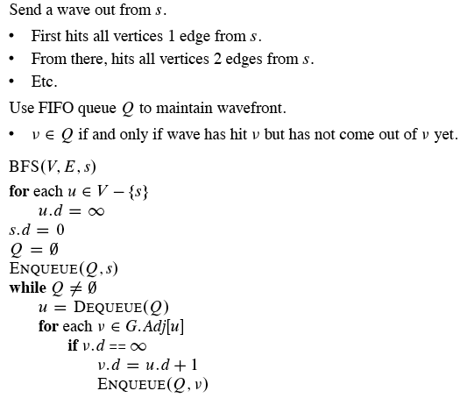
Idea

Slide 10
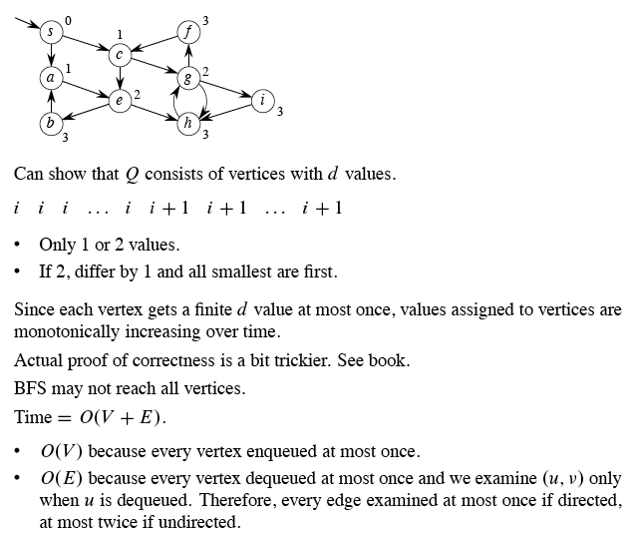
Example

Slide 11
Depth-first search

Slide 12
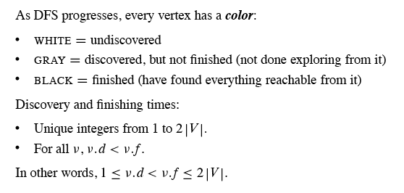
Depth-first search

Slide 13
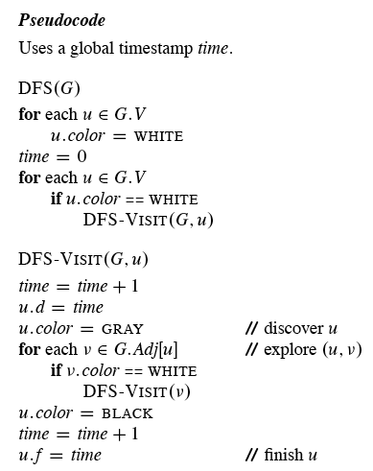
Depth-first search

Slide 14
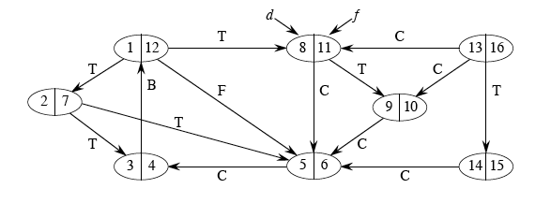
Example

Slide 15
Depth-first search

Slide 16
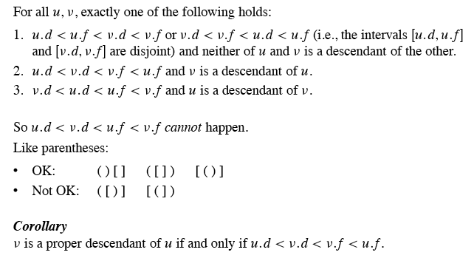
Theorem (Parenthesis theorem)

Slide 17
Theorem (White-path theorem)

Slide 18
Classification of edges

Slide 19
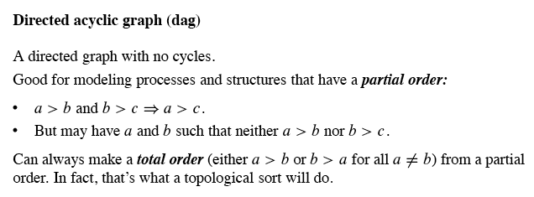
Topological sort

Slide 20
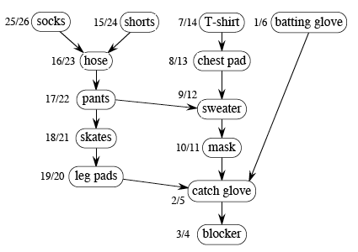
Example
Dag of dependencies for putting on goalie equipment:

Slide 21
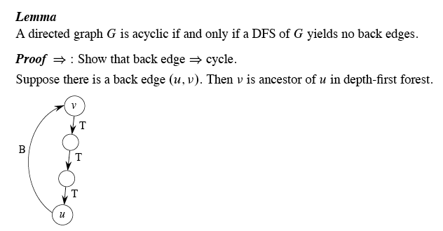

Slide 22
Topological Sort

Slide 23
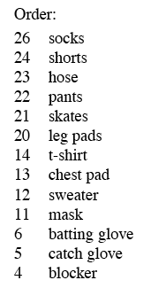
Example

Slide 24
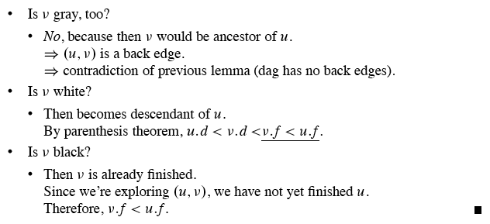
Correctness

Slide 25
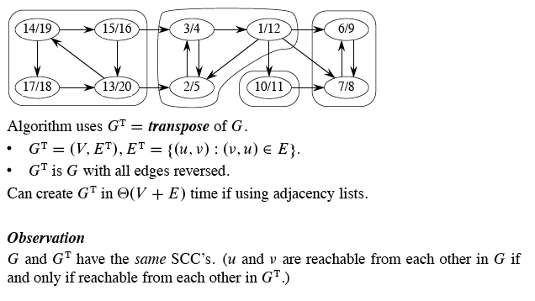
Strongly connected components

Slide 26
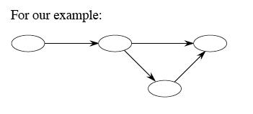
Component graph

Slide 27
Strongly Connected Components
STRONGLY CONNECTED COMPONENTS(G)
Call DFS(G) to compute the finishing times u.f for each vertex u
Compute G^{T}
Call DFS(G^{T}) but in the main loop of DFS, consider the vertices in order of decreasing u.f (as computed in point 1)
Output the vertices of each tree in the depth-first forest of step 3 as a separate strongly connected component

Slide 28
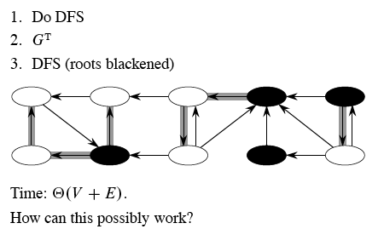
Example

Slide 29
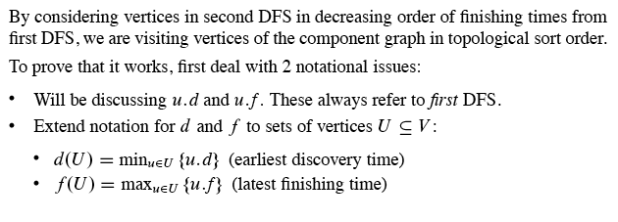
Idea

Slide 30
Next Topics
Chapter 23
Minimum Spanning Tree

