Slide 1
Minimum Spanning Trees
CS 46101 Section 600
CS 56101 Section 002
Dr. Angela Guercio
Spring 2010

Slide 2
Problem
A town has a set of houses and a set of roads.
A road connects 2 and only 2 houses.
A road connecting houses u and v has a repair cost w(u, v).
Goal: Repair enough (and no more) roads such that
everyone stays connected: can reach every house from all other houses, and
total repair cost is minimum.

Slide 3
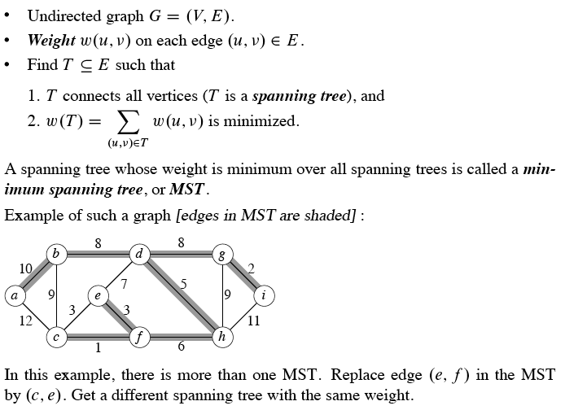
Model as a graph

Slide 4
Growing a minimum spanning tree
Some properties of an MST:
It has |V – 1| edges.
It has no cycles.
It might not be unique
Building up the solution
We will build a set A of edges.
Initially, A has no edges.
As we add edges to A, maintain a loop invariant:
Loop invariant: A is a subset of some MST.
Add only edges that maintain the invariant. If A is a subset of some MST, an edge (u, v) is safe for A if and only if A U (u, v) is also a subset of some MST. So we will add only safe edges.

Slide 5
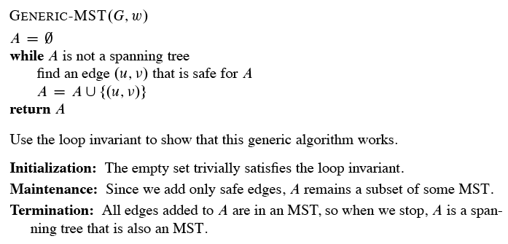
Generic MST algorithm

Slide 6
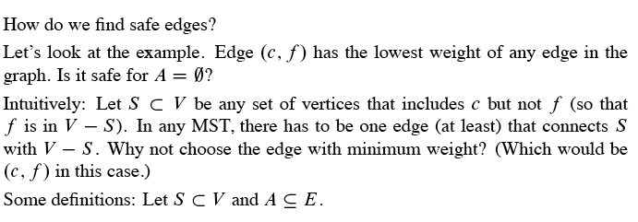
Finding a safe edge

Slide 7
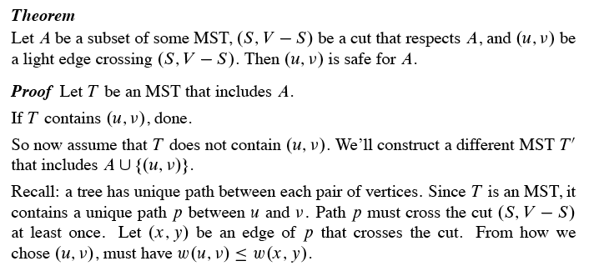
Theorem

Slide 8
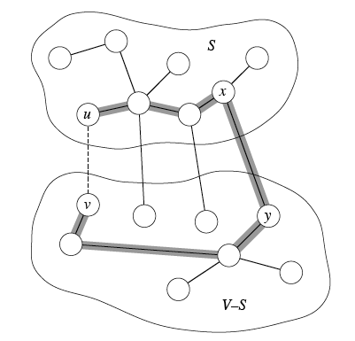

Slide 9
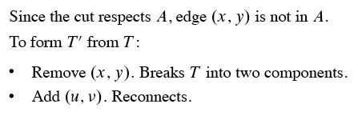
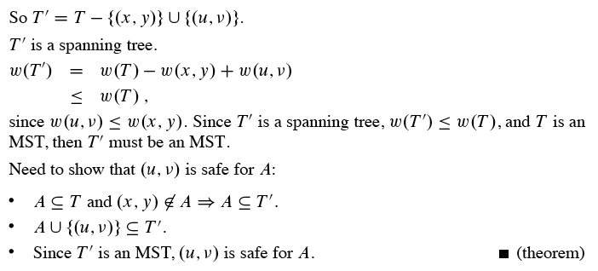

Slide 10
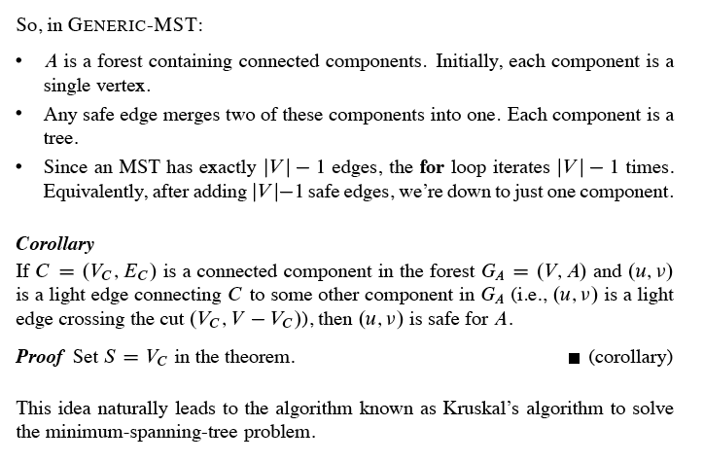

Slide 11
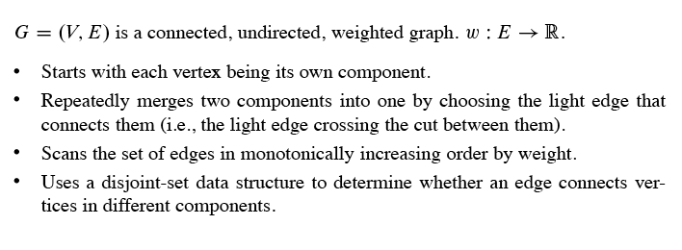
Kruskal’s Algorithm

Slide 12
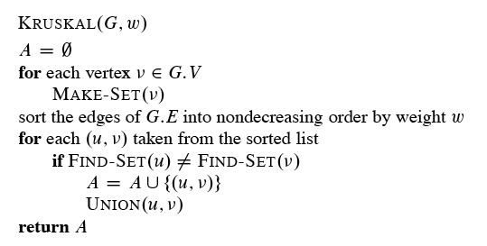
Kruskal’s Algorithm

Slide 13
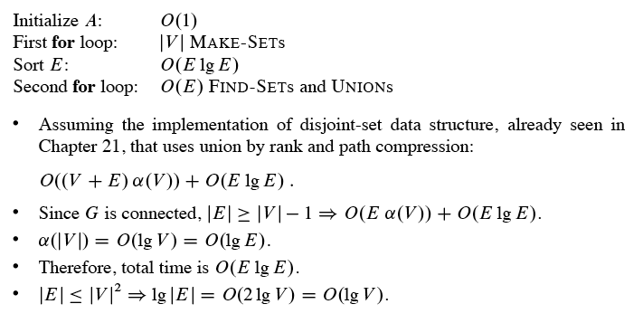
Analysis

Slide 14
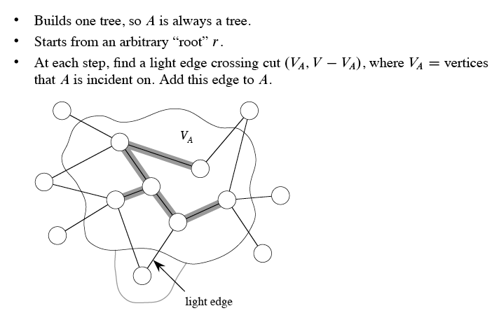
Prim’s Algorithm

Slide 15
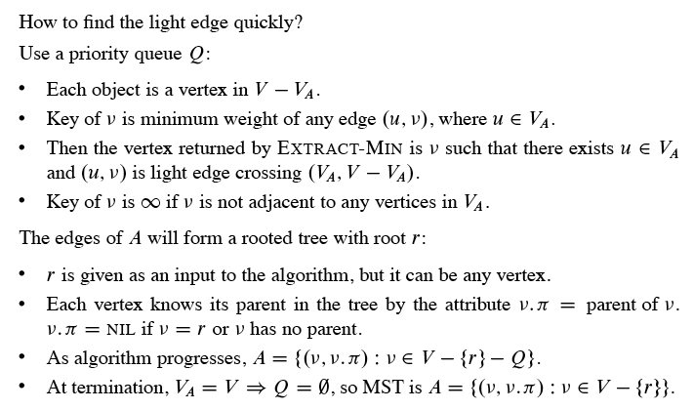
Prim’s Algorithm

Slide 16
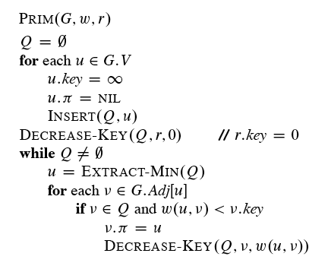
Prim’s Algorithm

Slide 17
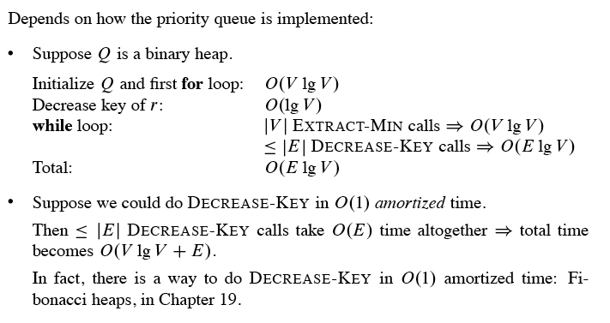
Analysis

