Slide 1
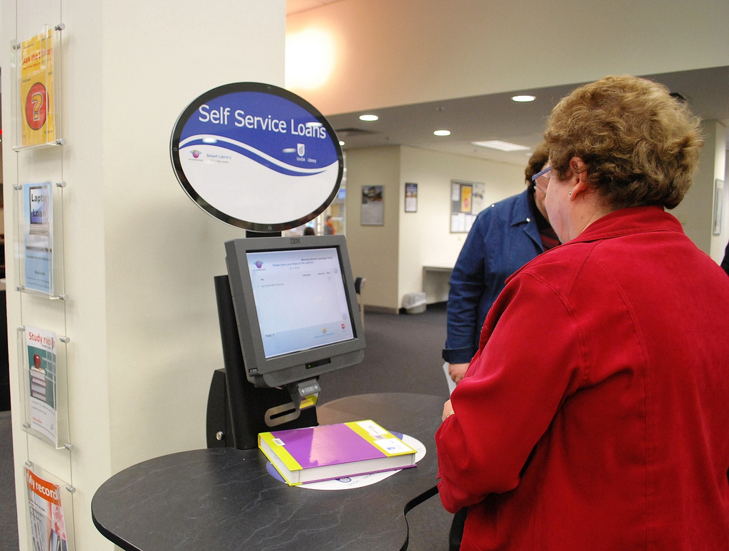
RFID (Radio-Frequency Identification)
And why Librarians need to know about it.

Slide 2
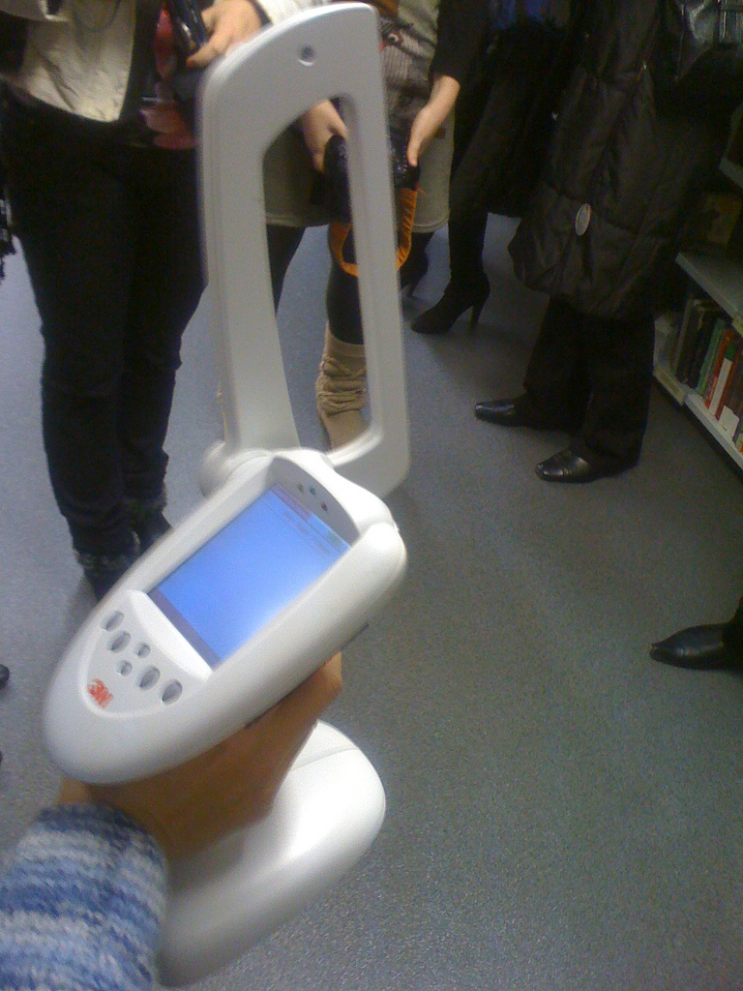
What RFID is (currently):
A radio frequency activated chip…more commonly known as a tag.
Tags relay their stored information (data) to a RFID reading device.
Tags can store all kinds of data…from a simple barcode to complete descriptions of the item they are on, and more.

Slide 3
Why librarians need to know about RFID
RFID is currently used in libraries for:
check-in / check-out of items,
security / anti-theft reasons.
inventory.

Slide 4
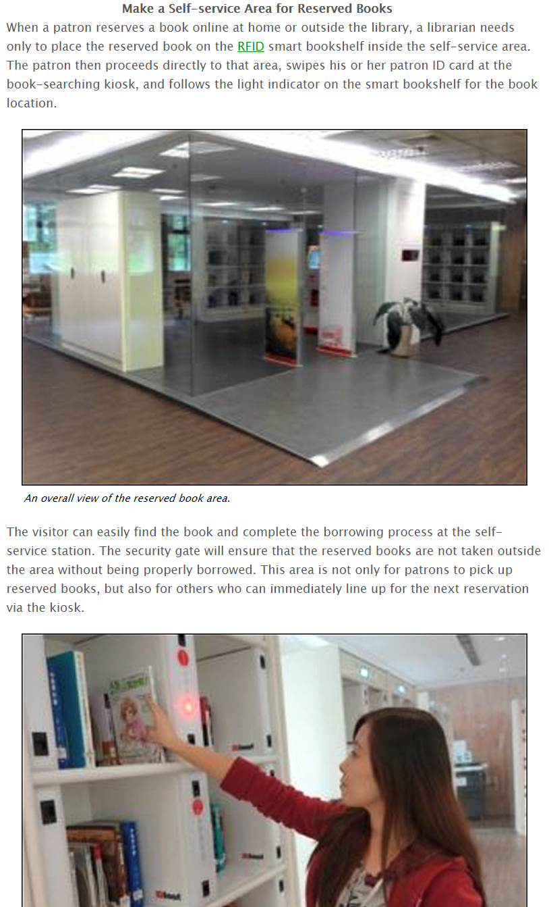
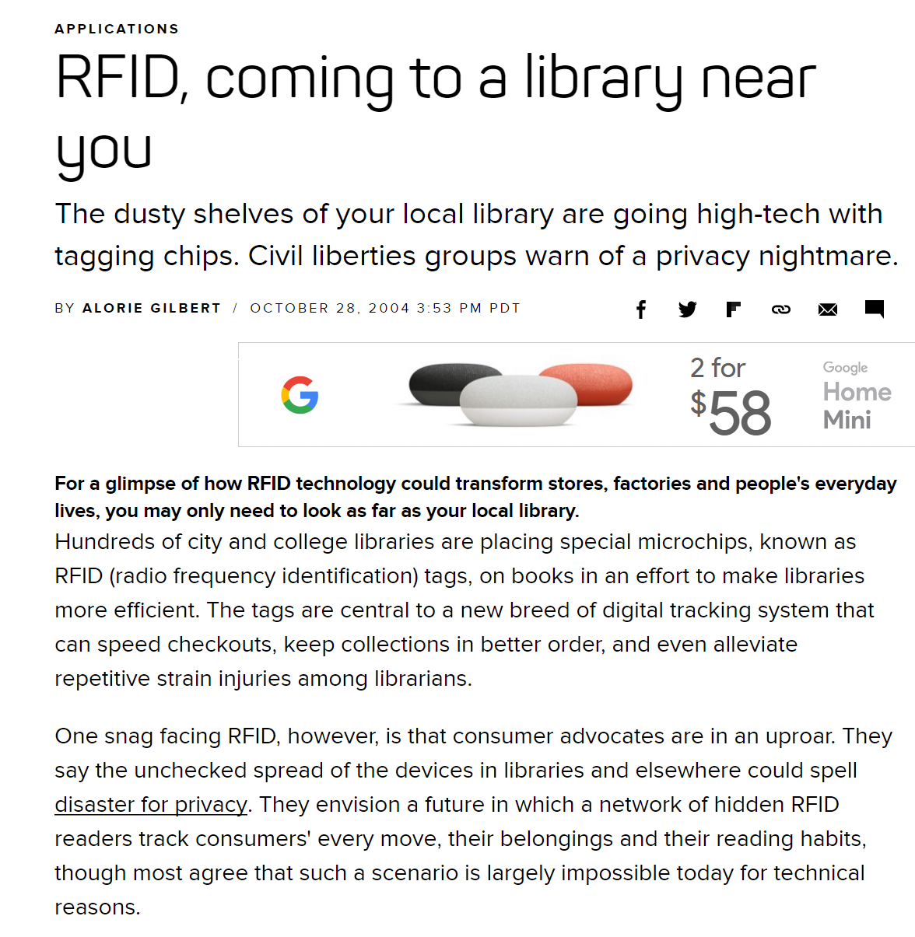
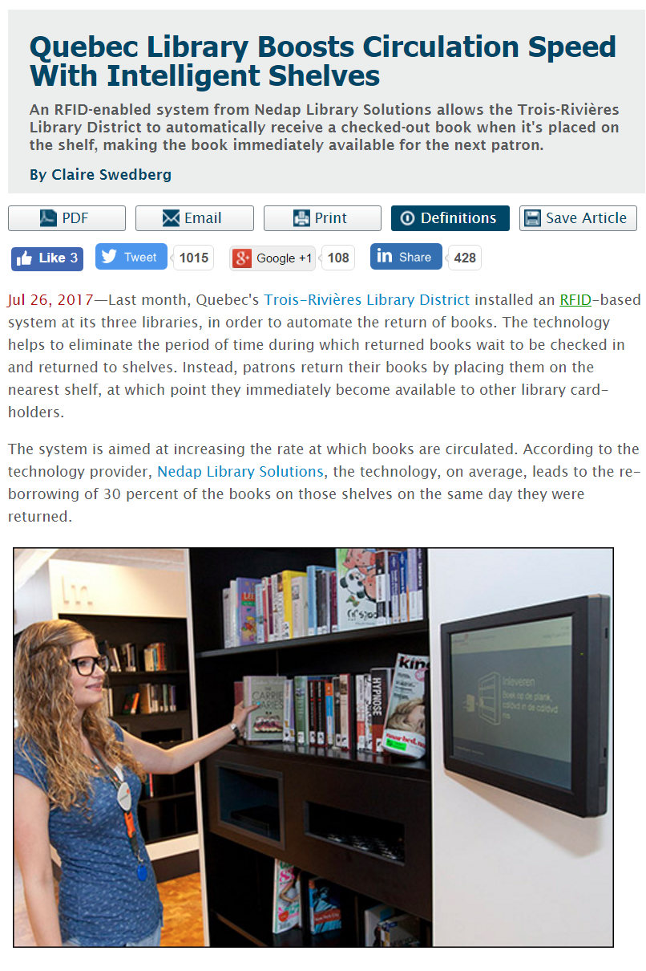
Where the technology is already going.
Smart Shelving: in other words shelves that know what is on them!
Source(s): http://www.rfidjournal.com/articles/view?16360
http://www.rfidjournal.com/articles/view?13264
https://www.cnet.com/news/rfid-coming-to-a-library-near-you/

Slide 5
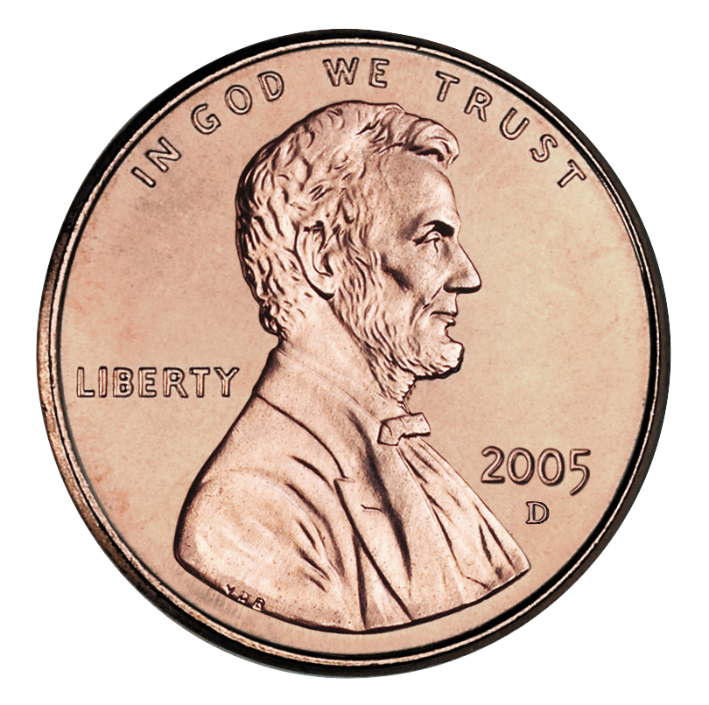
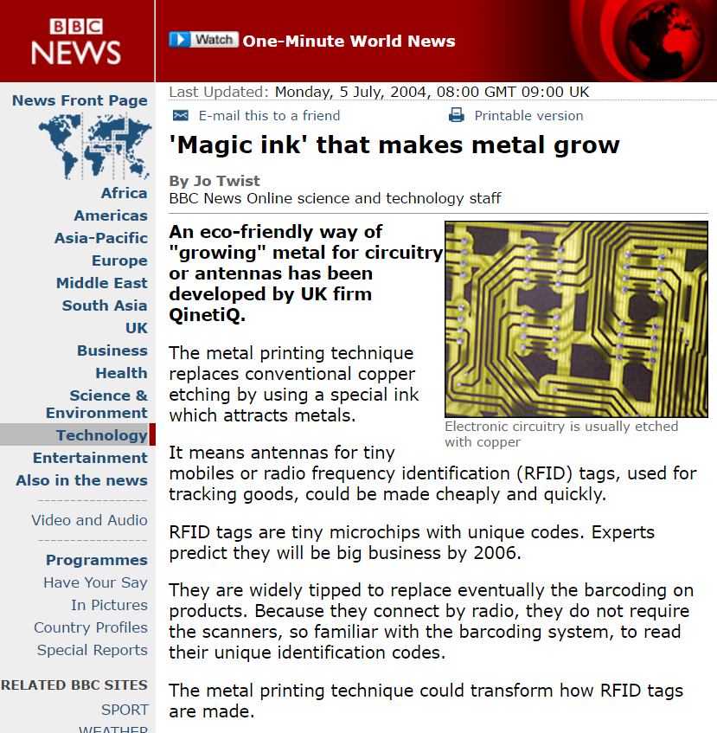
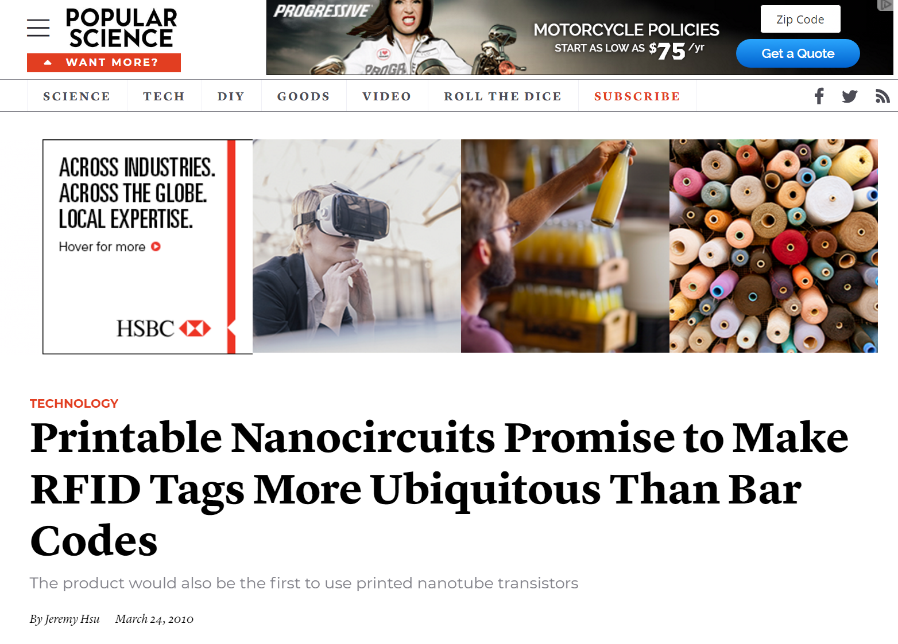
Where it’s going continued.
Expected Price Tag
Each
Printable RFID tags (and other technology too).
Source(s):
http://news.bbc.co.uk/2/hi/technology/3860229.stm
https://www.popsci.com/technology/article/2010-03/cheap-plastic-rfid-tags-promise-replace-bar-codes

Slide 6
Where it’s going continued.
Robbie the Robot Page…is real already, and he uses RFID tags to get the job done.
Source:
https://phys.org/news/2016-06-automated-robot-scans-library-shelves.html

Slide 7
What this means for the future of libraries.
No more lost items … Each item will know where they are…and so will the shelves they are on.
No more unreturned items … patrons or police can have a portable RFID scanner that will tell them where the item is (if it’s in range) possibly even as part of their cell phones.
No more shelving items…if you can afford the robot.
A lot more time to focus on everything else libraries will be doing!

Slide 8
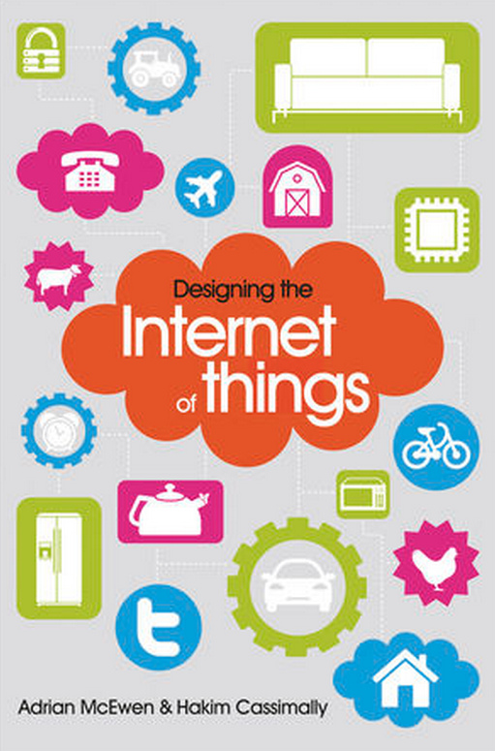
Ultimate goal of the RFID manufacturers
Create the Internet of Things (about 10 – 15 years away.)
Everything that is created talks to everything else.
All our stuff talks to us via computers – yes your phone counts.
The end goal is to make are lives easier… maybe.

Slide 9
Concerns with RFID technology
Privacy
Trackability
Or put simpler all the horrible things we read about in 1984… Big brother will really be watching. Only he’s not just the government he’s corporate marketing divisions too.

Slide 10
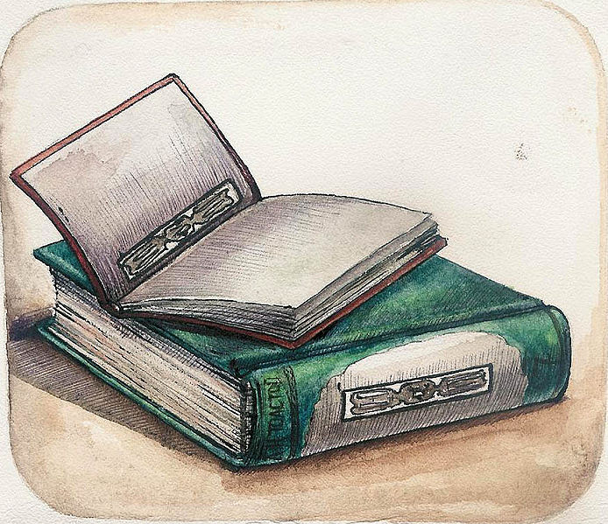
Questions?

